Slide 1



Data for the Planet: FAIR data, cross-domain science and CODATA
Simon Hodson
Executive Director
CODATA
www.codata.org
Ask Me Anything Webinar
RDA Early Career Interest Group
16 October 2019

Slide 2

CODATA, the Committee on Data of the International Science Council
CODATA supports ISC’s mission of advancing science as a global public good: http://bit.ly/ISC-Science-Action-Plan
CODATA promotes global collaboration to make data work to improve science to support decision-making
CODATA develops policy recommendations to enhance data sharing and re-use, promotes good data practices, explores frontier issues in data science, and advances education and training in data skills.
CODATA membership: national committees, international scientific unions and associations, and organisations.
CODATA is a community of interest and expertise. We act strategically through ISC supported initiatives, through projects and Task Groups.

Slide 3
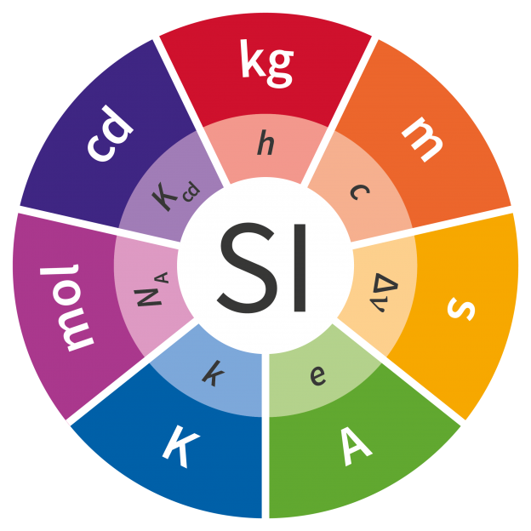
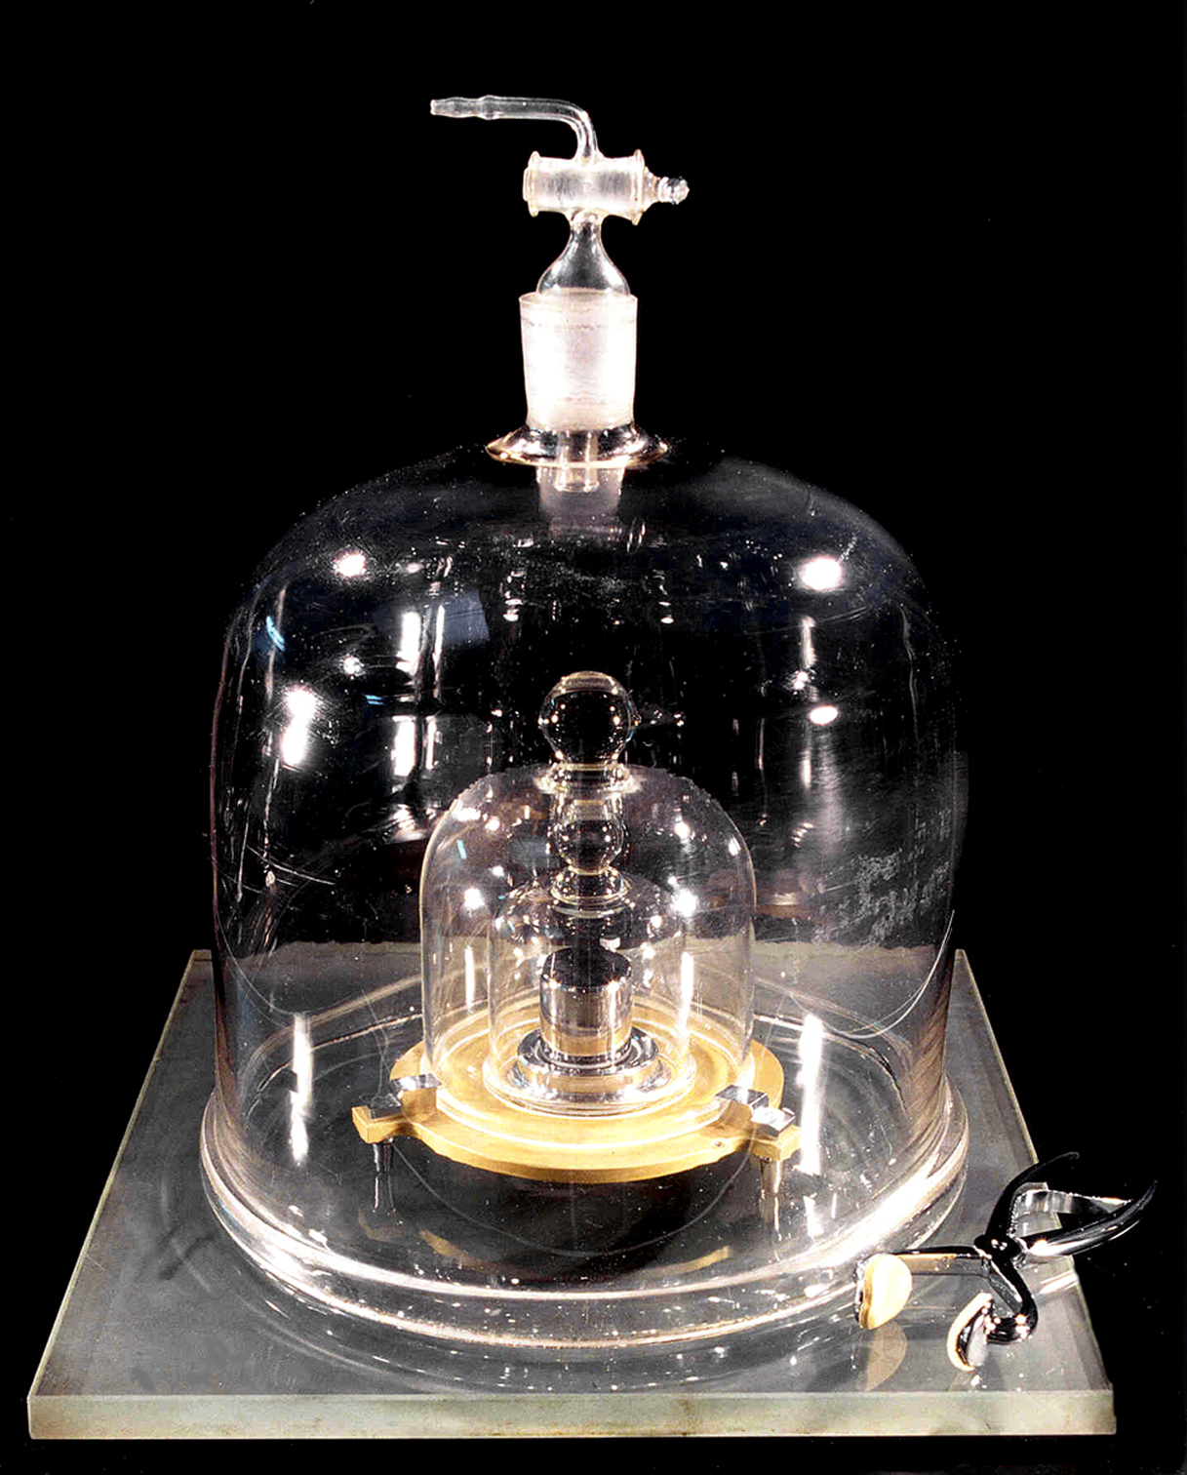

Revision of the SI Units and the CODATA Fundamental Physical Constants
Major revision of the SI Units agreed on 16 November 2018; came into force on 20 May 2019.
The kilogram, ampere, kelvin and mole will now be based, respectively on the Planck constant h, the elementary charge e, the Boltzmann constant k, and the Avogadro constant NA.
See http://bit.ly/codata-fundamental-constants and http://iopscience.iop.org/article/10.1088/1681-7575/aa950a/pdf

Slide 4


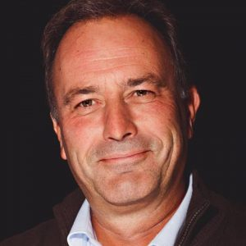
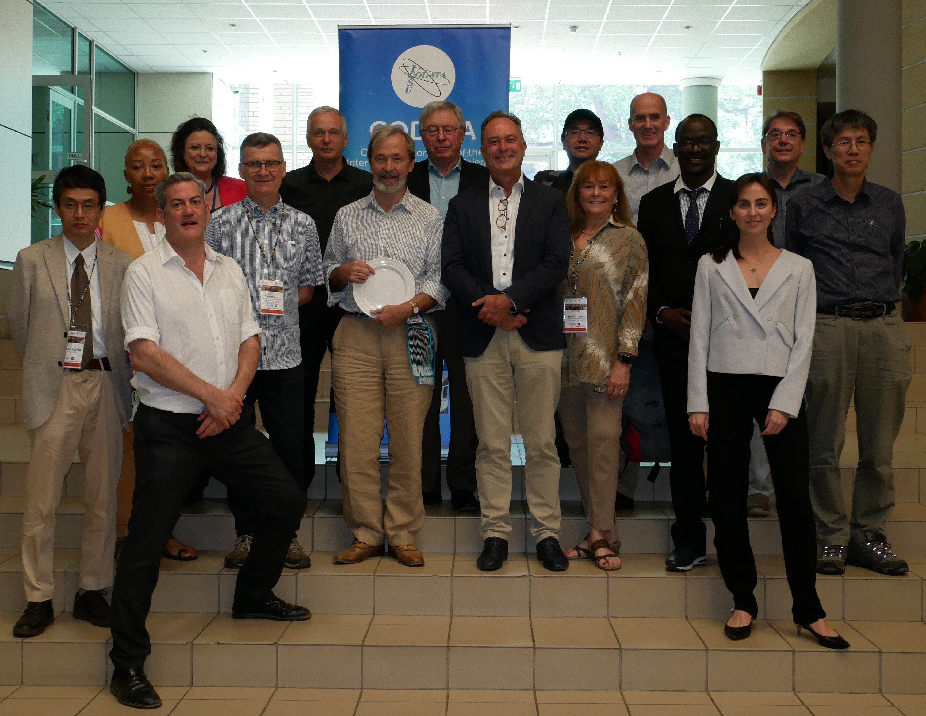

Open Science and FAIR Data
CODATA President, 2014-2018, Geoffrey Boulton, lead author of ‘Science as an Open Enterprise’.
Significant driver is good scientific practice: ‘to fail to communicate the data that supports scientific assertions is tantamount to malpractice’.
Data should be intelligently open – and intelligibly open.
CODATA General Assembly Nov 2018, elected new CODATA President, Barend Mons and a new Executive Committee.
One of the originators of the FAIR principles and of the GO FAIR initiative.
FAIR is a neat encapsulation of what is needed for data to be usable at scale.

Slide 5
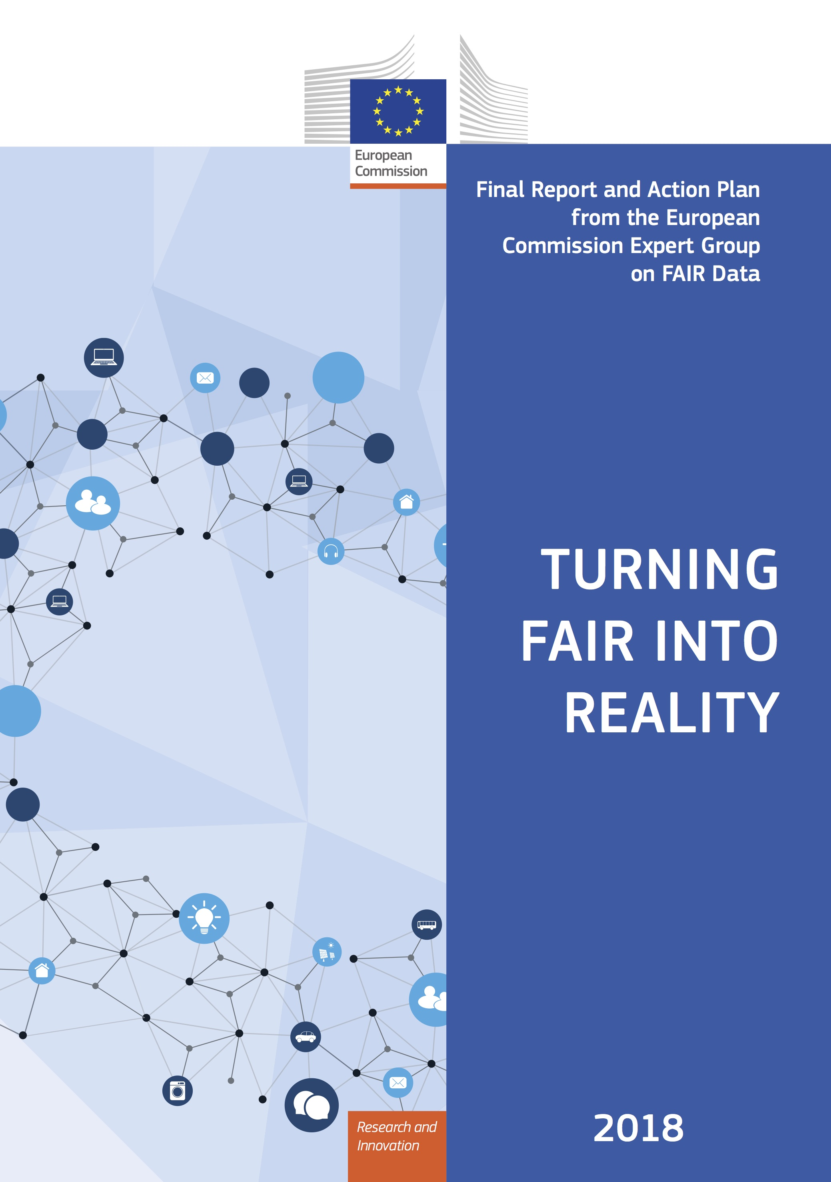

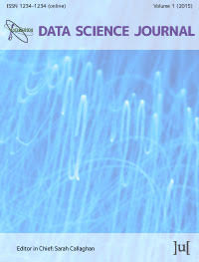
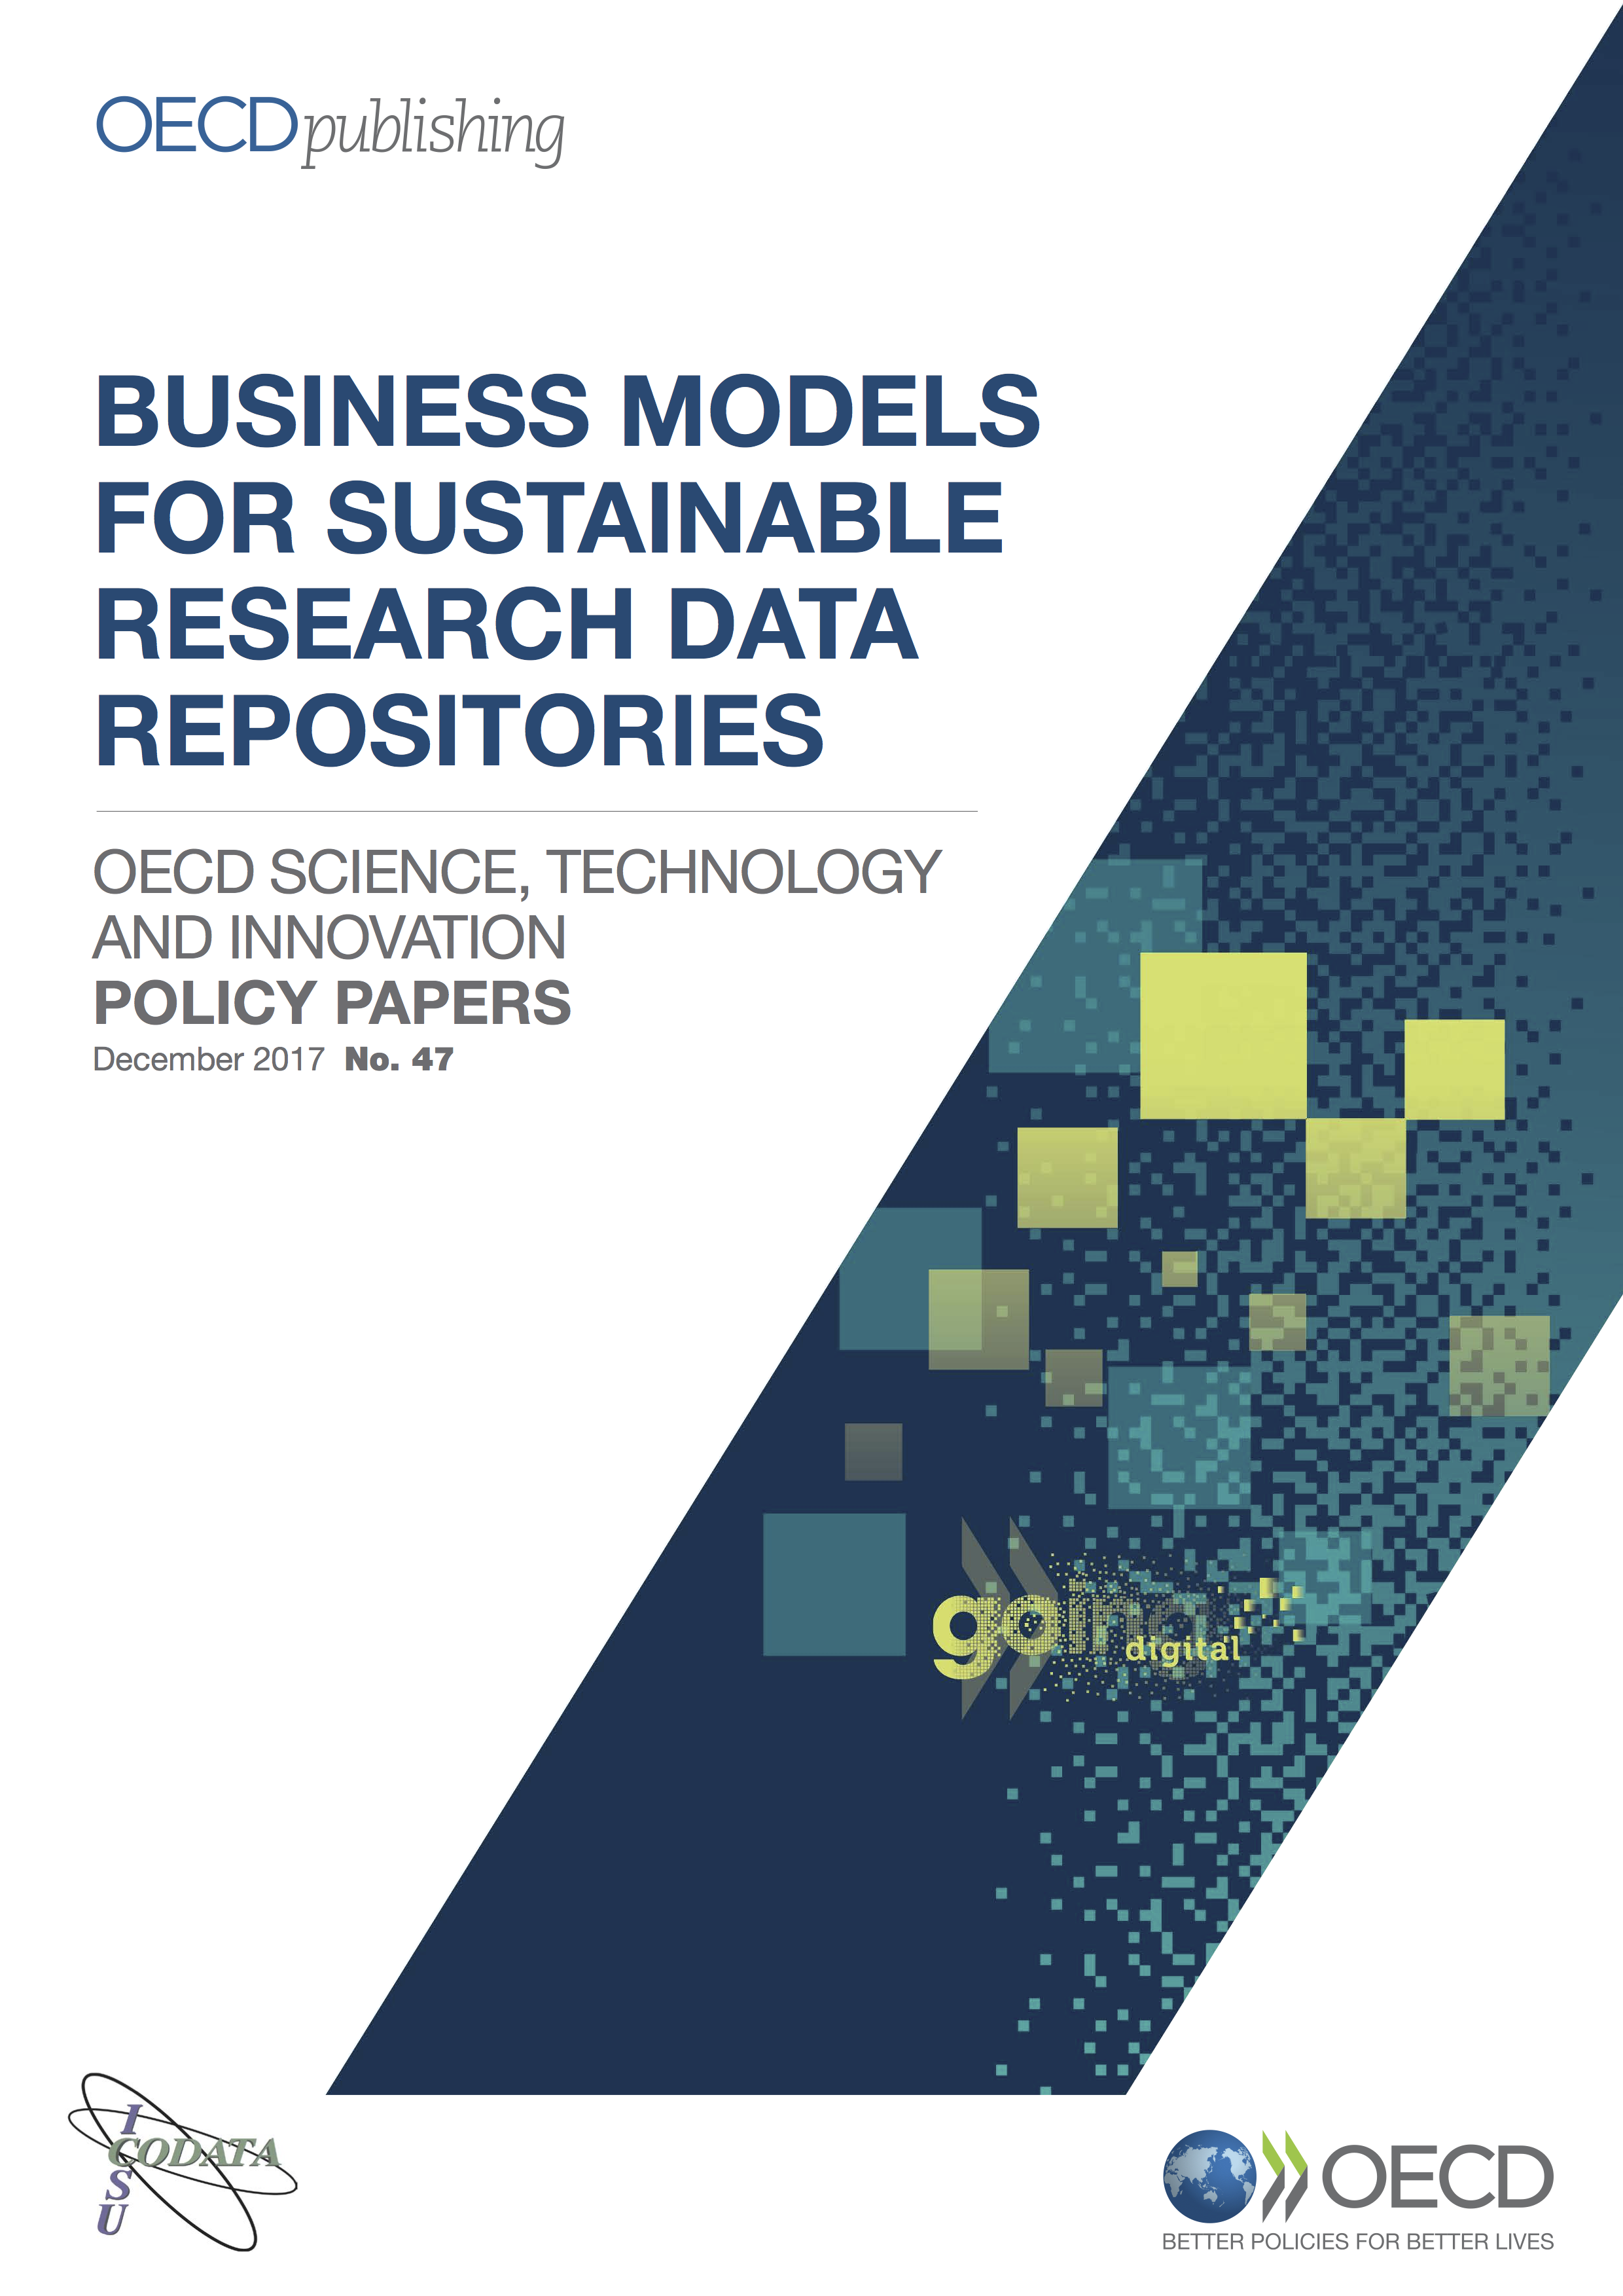

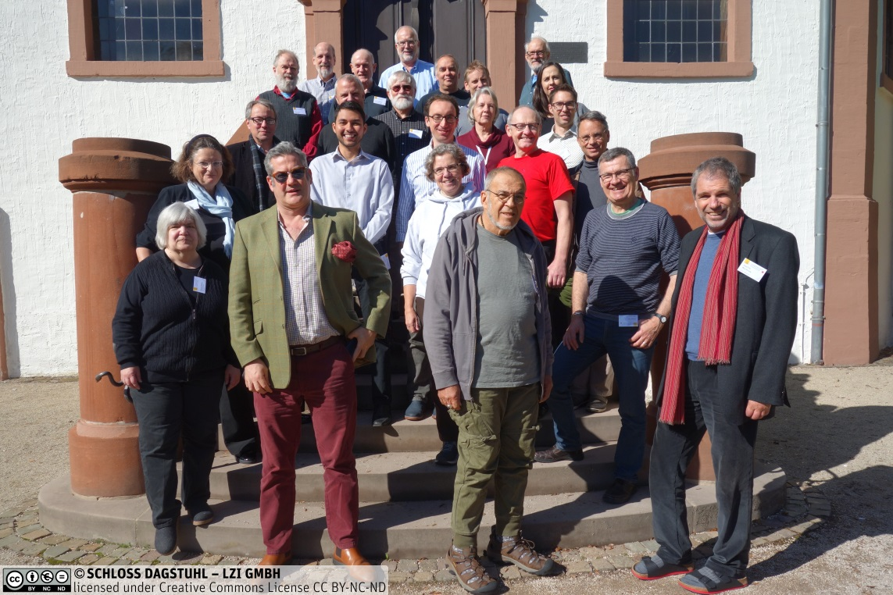


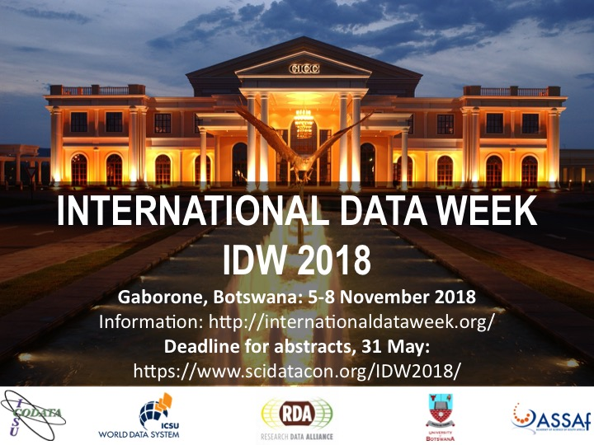
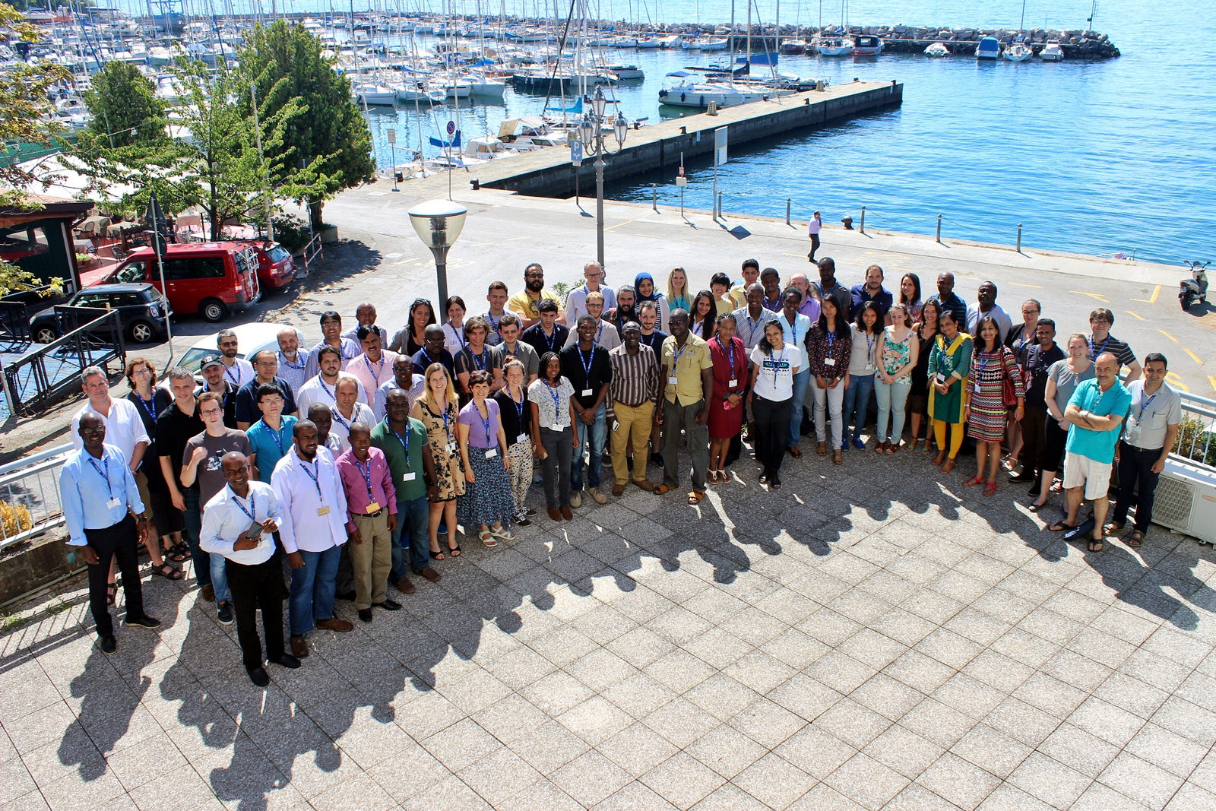
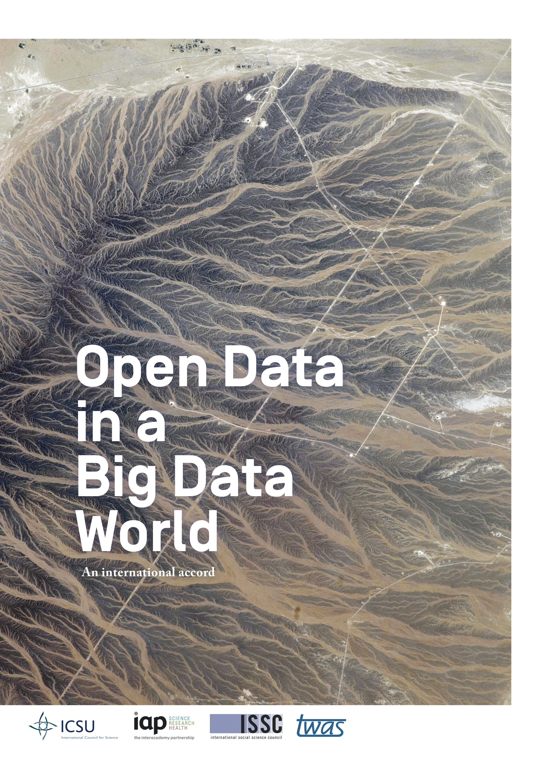


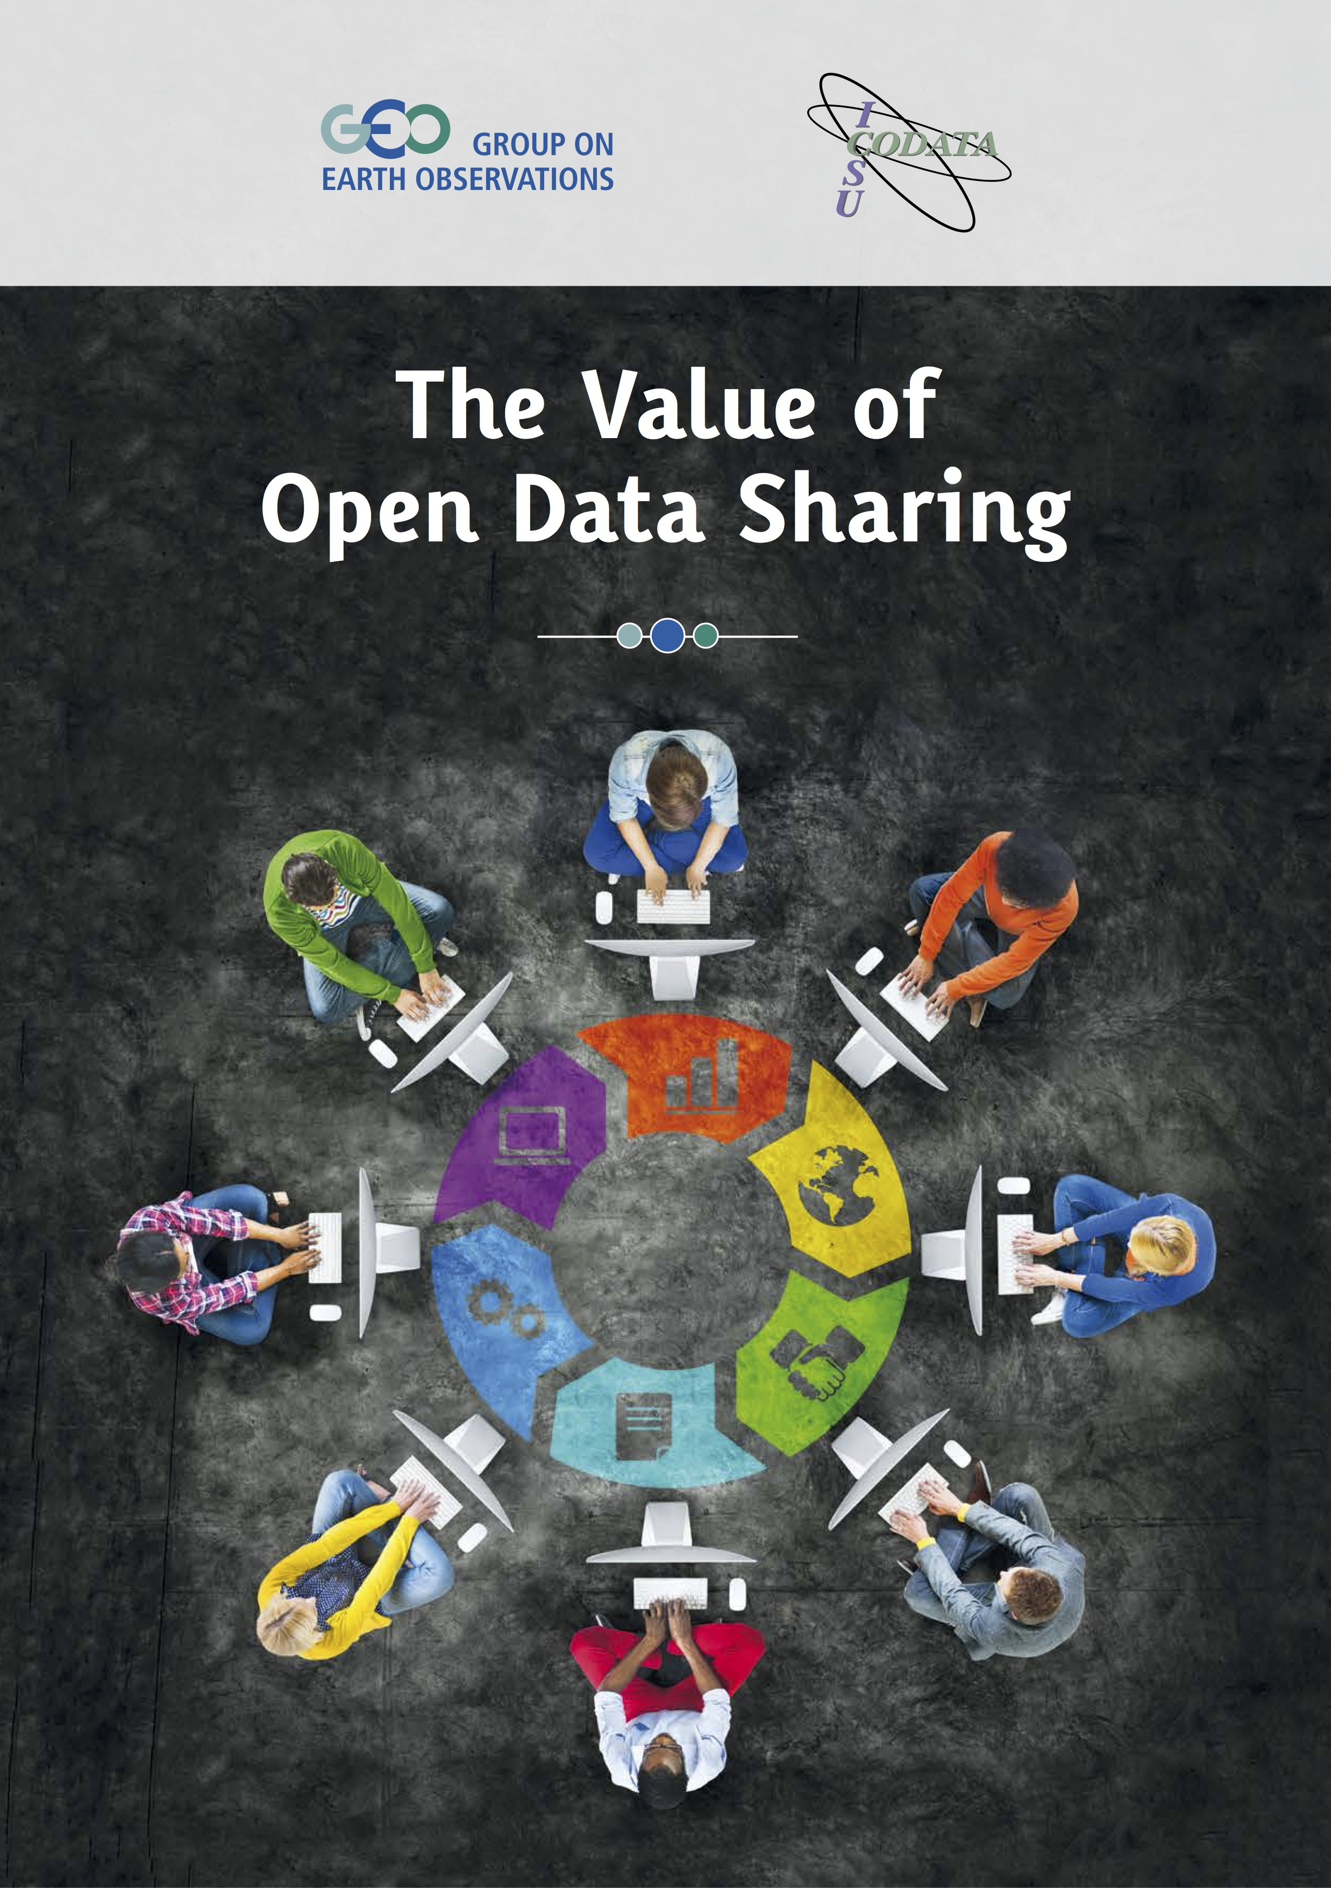


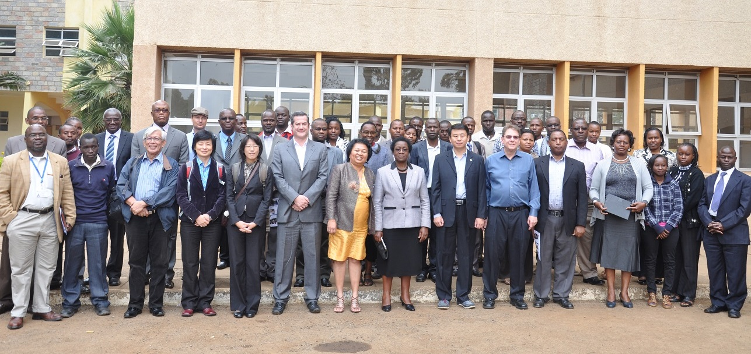
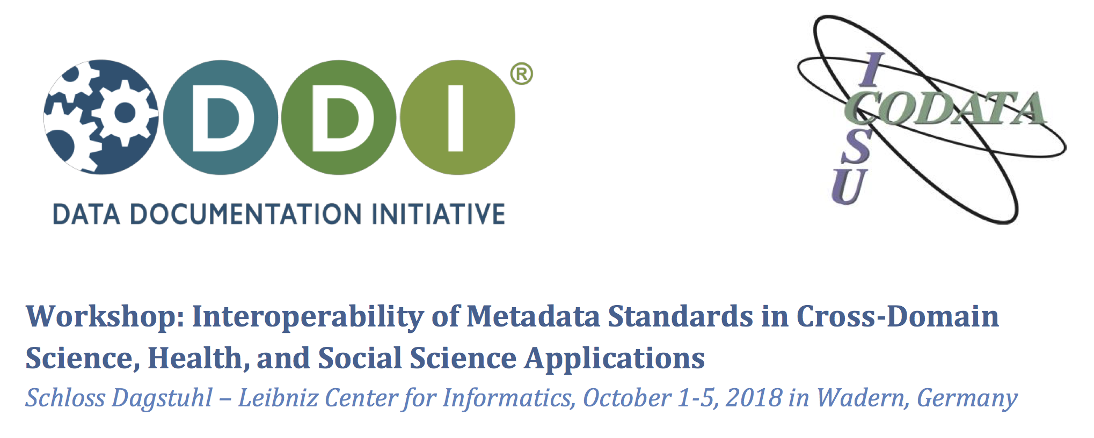
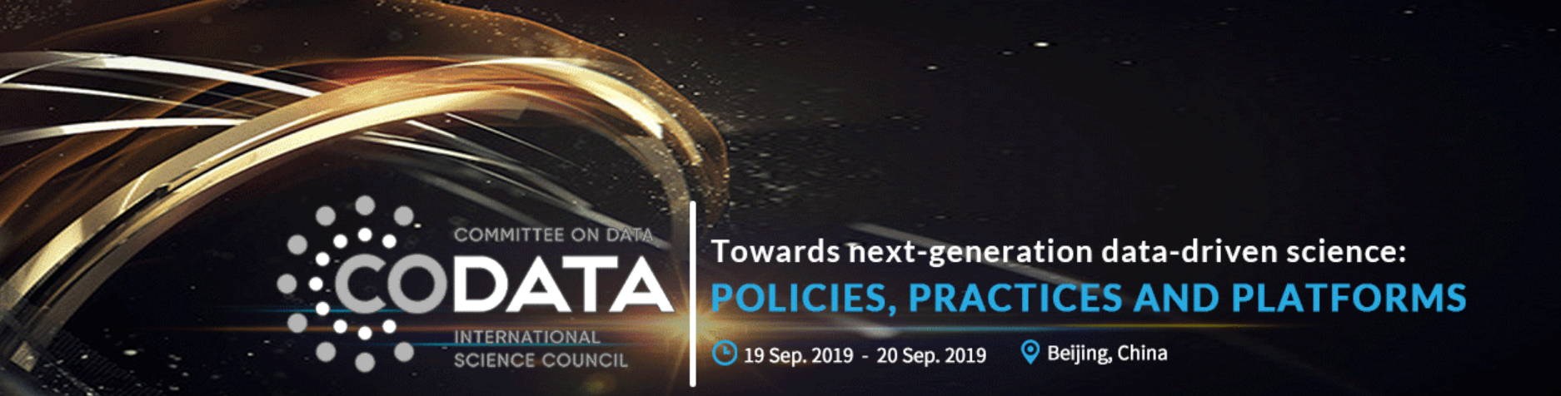

Data Policies
Data Science
Data Skills
Data Good Practices
CODATA Data Policy Committee http://bit.ly/data-policy-committee;
One major policy report per year.
20-Year Review of GBIF currently underway.
New Centre of Excellence in Data for Society being set up at University of Arizona.
CODATA-RDA School of Research Data Science.
CODATA China, PASTD and other training activities.
#terms4FAIRskills and FAIRsFAIR Competence Centres.
Data Science Journal: https://datascience.codata.org/
International Data Week and CODATA Conference series.
Task Groups and Working Groups.
Regional Open Science Platforms
Data Interoperability for Multi-Disciplinary Research.
Survey and recommendation of good practices.

Slide 6

Formed by a merger of the International Council for Science and the International Social Science Council.
Explicit mission for ALL the sciences and for interdisciplinary and transdisciplinary research.

Slide 7



Making Data Work for Global,
Cross Domain Challenges
The major, pressing global scientific and human issues of the 21st century can ONLY be addressed through research that works across disciplines to understand complex systems, and which uses a transdisciplinary approach to turn data into knowledge and then into action.
Require the ability to gather data from multiple varies sources and extract information from those complex and heterogeneous data.
The digital and data revolution presents us with huge opportunities and significant challenges.
Better exploitation of data resources for research is the epochal challenge of the 21st century.
With the merger of ICSU and ISSC to form the International Science Council, addressing the data revolution and global challenges is a priority.

Slide 8
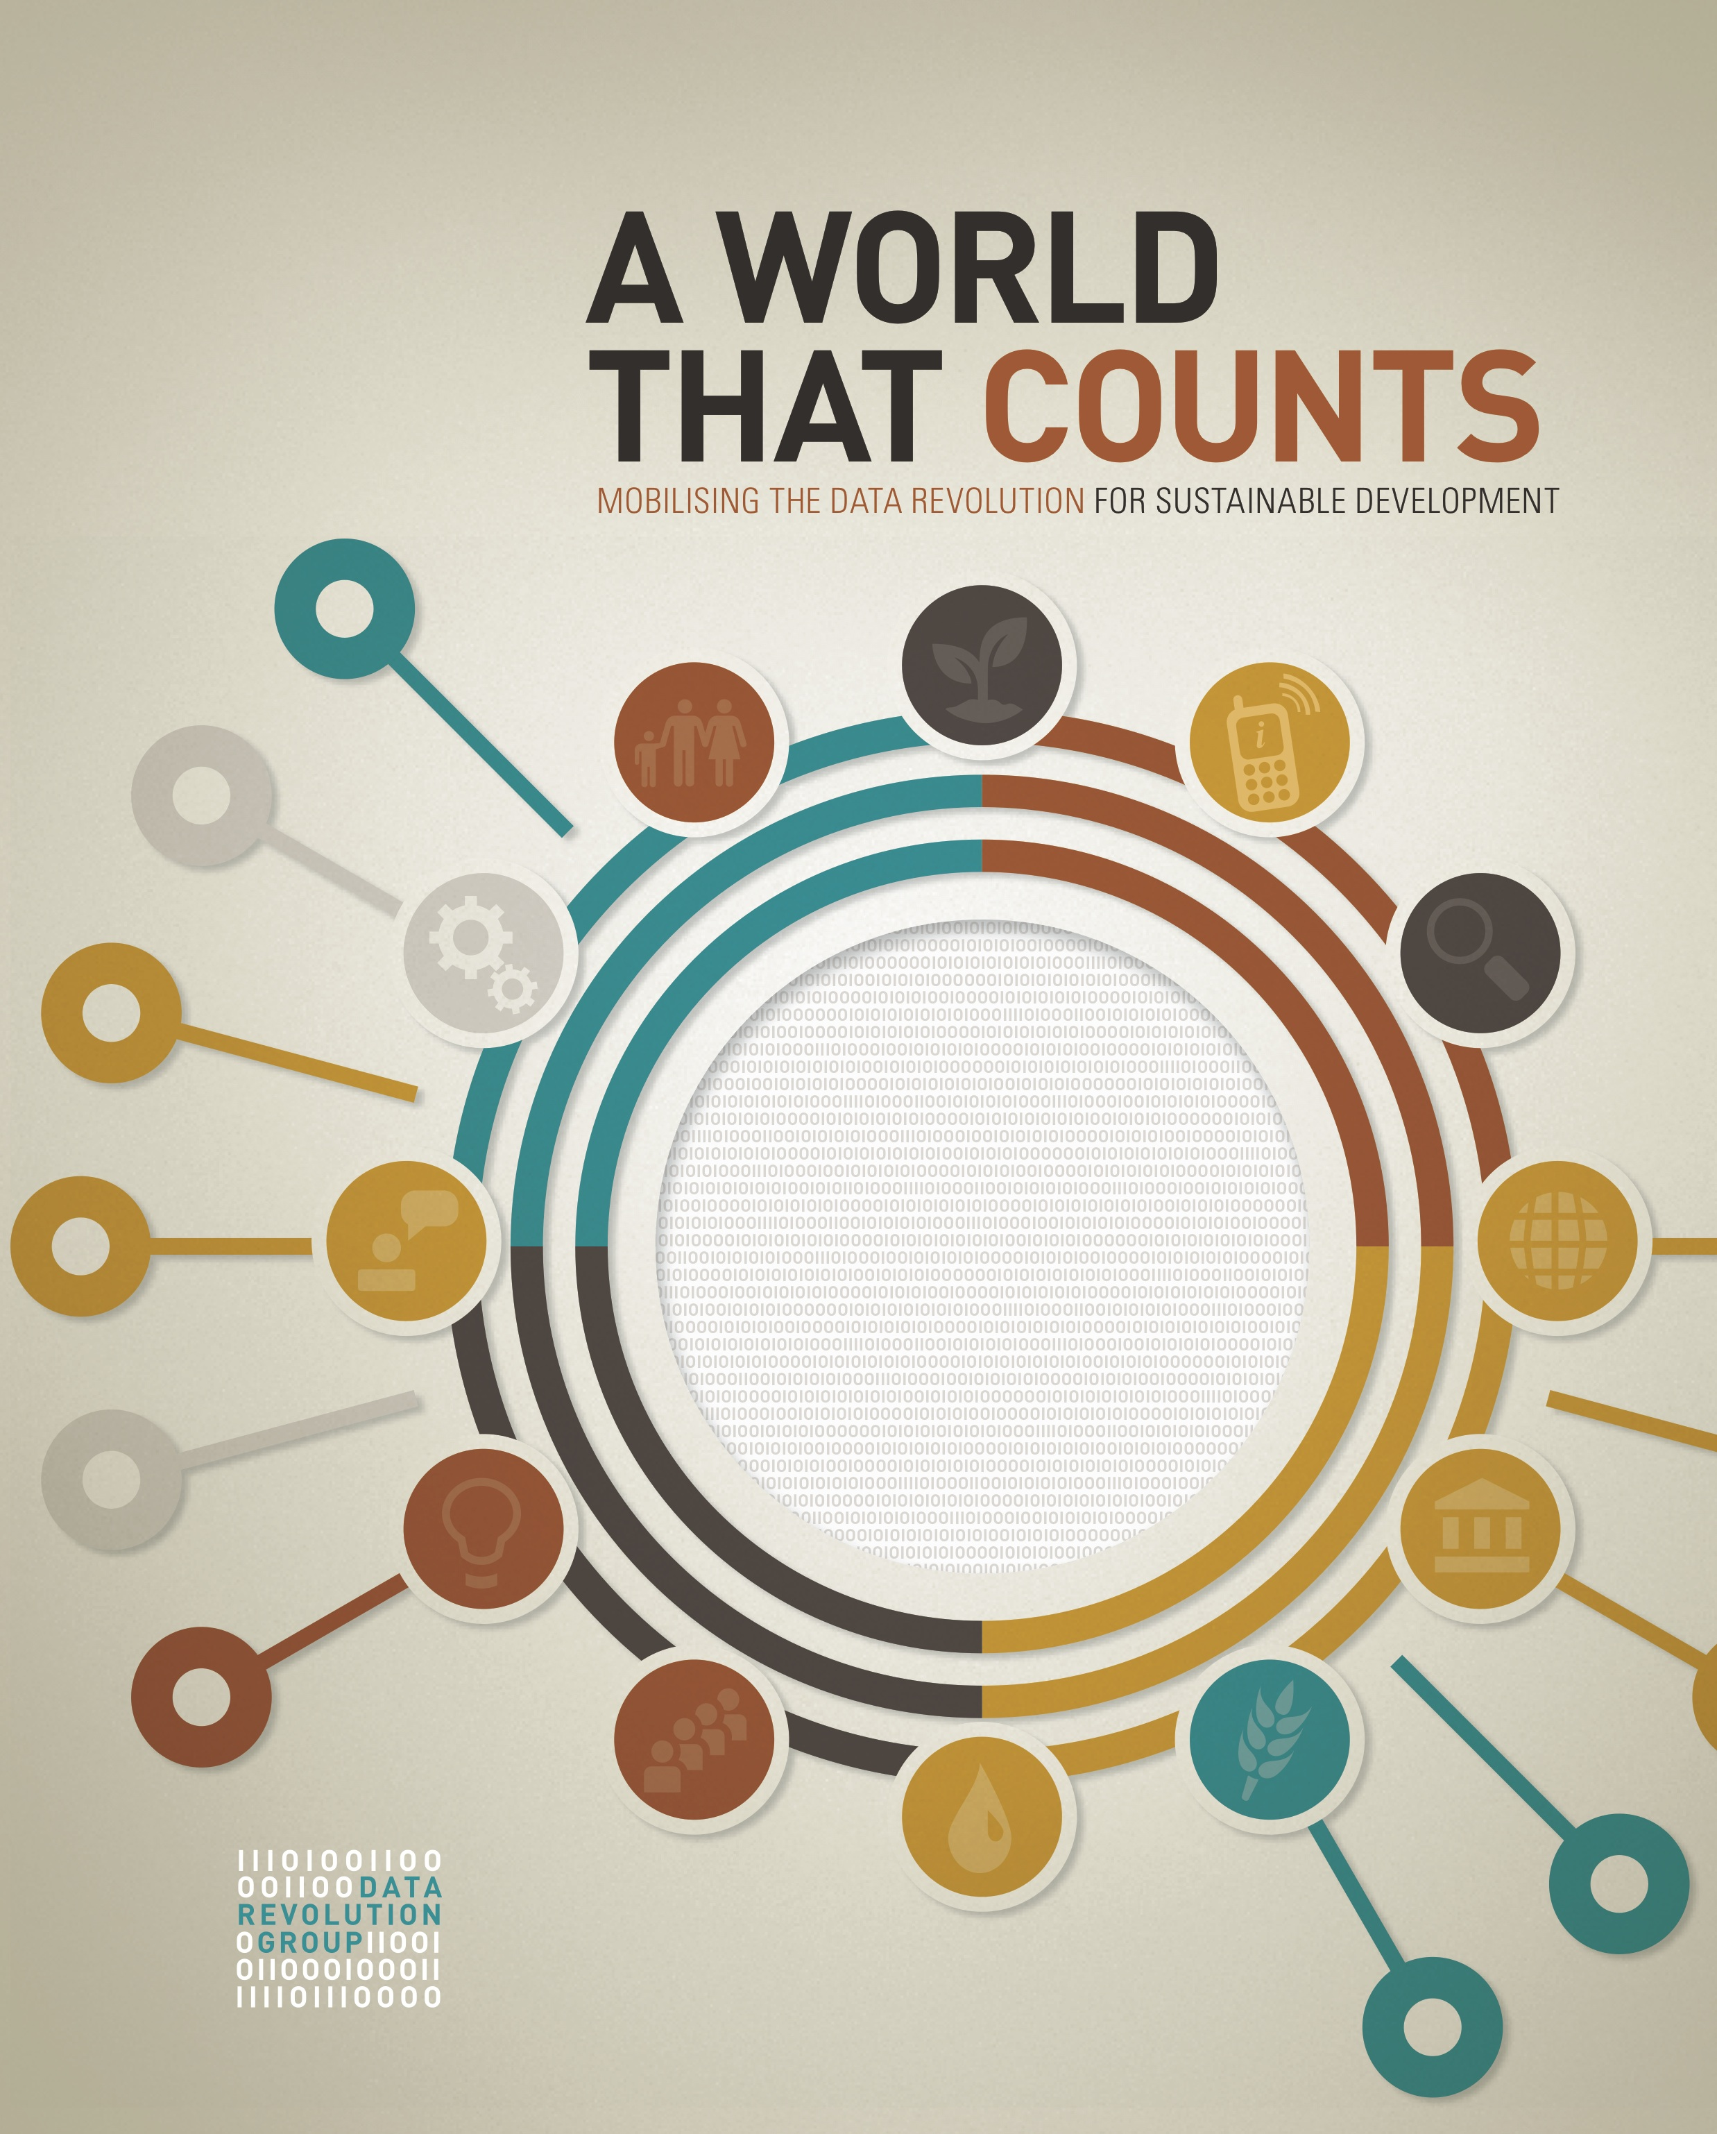
A World that Counts: mobilising the data revolution for sustainable development
A World that Counts - A World that Matters.
A world that counts and measures itself in order to understand itself.
Measurement of things is a sine qua non to understanding.
Qualitative understanding is essential.
The things we measure are interelated and often affected by the act of measuring.
Overemphasis on one or other metric can have very negative effects.
‘[T]here is an urgent need to mobilise the data revolution for all people and the whole planet in order to monitor progress, hold governments accountable and foster sustainable development.’
Need to upskill data providers and harness many other data sources.
Role of scientific community is essential.
Indicators and metrics are complicated, need to by viewed critically. They are interrelated and need to be examines as a system.

Slide 9


Big Data: Of course, the capacity to create huge volumes of extremely valuable data (Earth observation, sensor networks, environmental monitoring, human activity…) has huge scientific and societal potential.
Little Data: Data that are essential to understanding a given phenomenon can be very small (in volume) and require considerable stewardship and analysis.
NO DATA: The major challenge remains that for many issues we simply do not have the data we need!

Slide 10
Findable: have sufficiently rich metadata and a unique and persistent identifier, to enable discovery.
Accessible: retrievable by humans and machines through a standard protocol; authentication and authorization where necessary.
Allows programmatic access for analysis.
Interoperable: metadata use a ‘formal, accessible, shared, and broadly applicable language for knowledge representation’.
The descriptions of variables etc follow a shared specification and are commensurable.
Reusable: metadata provide rich and accurate information; clear usage license; detailed provenance.
Both humans and their analytical tools know what can be done with the data (license) and can assess its provenance.
European Commission Expert Group, Chaired by Simon Hodson, Turning FAIR into Reality (2018) https://doi.org/10.2777/1524

Slide 11
CODATA and ISC Data Interoperability Pilot
The initiative addresses data interoperability for pressing, 21st century global challenges, initially through three closely-allied interdisciplinary research areas:
Infectious Diseases (IDDO)
Disaster Risk Reduction (CODATA TG, PHE, IRDR)
Resilient Cities (Resilience Brokers)
With global collaboration within and across domains and disciplines, the overall activities are designed to:
have practical outputs of value to policymakers and users;
to develop technical approaches and methods that have generic value; and
to be persuasive demonstrators to the broader scientific community of the value of the approach.
WIDER STAKEHOLDERS
Domestic and International Policymakers / Users
PROJECT DOMAINS
STAGES
Stage 3) High-level
integration
Stage 2) Full project
Stage 1) Pilot project
TIME
Infectious Disease
(A)
Disaster
Risk R.
(B)
Resilient Cities
(C)
DOMAIN SCIENTISTS
DATA PROVIDERS
DATA SCIENTISTS
COLLABORATORS
Data science groups
Data services
Other programmes
FUNDERS SPONSORS

Slide 12
CODATA and ISC Data Interoperability Pilot: Methodology
What is the overarching question or challenge that is being addressed?
What are the data sets which, ideally, need to be accessed, assembled in order to address these questions?
Who ‘owns’ the data? What is the licensing and use regime?
Where are the data stored? What are the access requirements?
What is the data format?
What is the metadata format used? What provenance information is provided? Can fitness for use be assessed?
How are the variables defined? What semantics, controlled vocabularies or ontologies are used to define these qualities, values?
Is code associated with processing/analyzing the data available?
Problem Definition:
Interdisciplinary or transdisciplinary research on topics where there is a need for data integration.
Domains include:
Infectious Diseases
Disaster Risk Reduction (DRR)
Resilient Cities
Data Integration Intelligence Methodology:
Phase 1:
Understanding the pilot
Phase 2:
Understanding the data
Phase 3:
Identifying opportunities for data integration
Phase 4:
Identifying recommendations and requirements
Data integration recommendations
Phase 5: Implementation of Data Integration Intelligence
Interoperability and data integration solutions
Phase 6:
Enhanced
Research
Innovative research outcomes and recommendations
Phase 7:
Distilling Generic Lessons for Data Integration and Enhanced Research
Recommendations for interdisciplinary research; recommendations for societal actors.

Slide 13
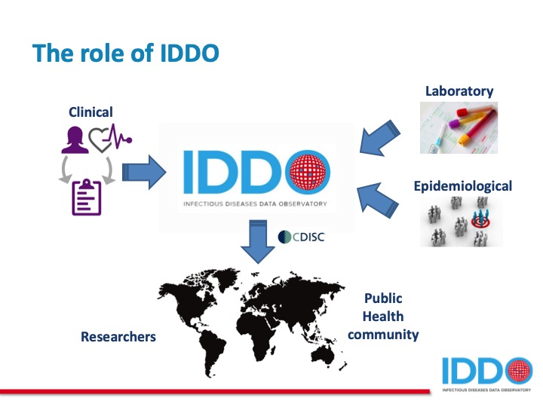

Slide Credit: Fernando Gouveia Reis and Laura Merson, IDDO
Infectious Diseases Data Observatory, Oxford.
IDDO collects and integrates clinical, laboratory and epidemiological data relating to a number of infectious diseases.
Analysis of combined datasets increases the power to determine optimal treatments, identify the most effective intervention in outbreaks.

Slide 14
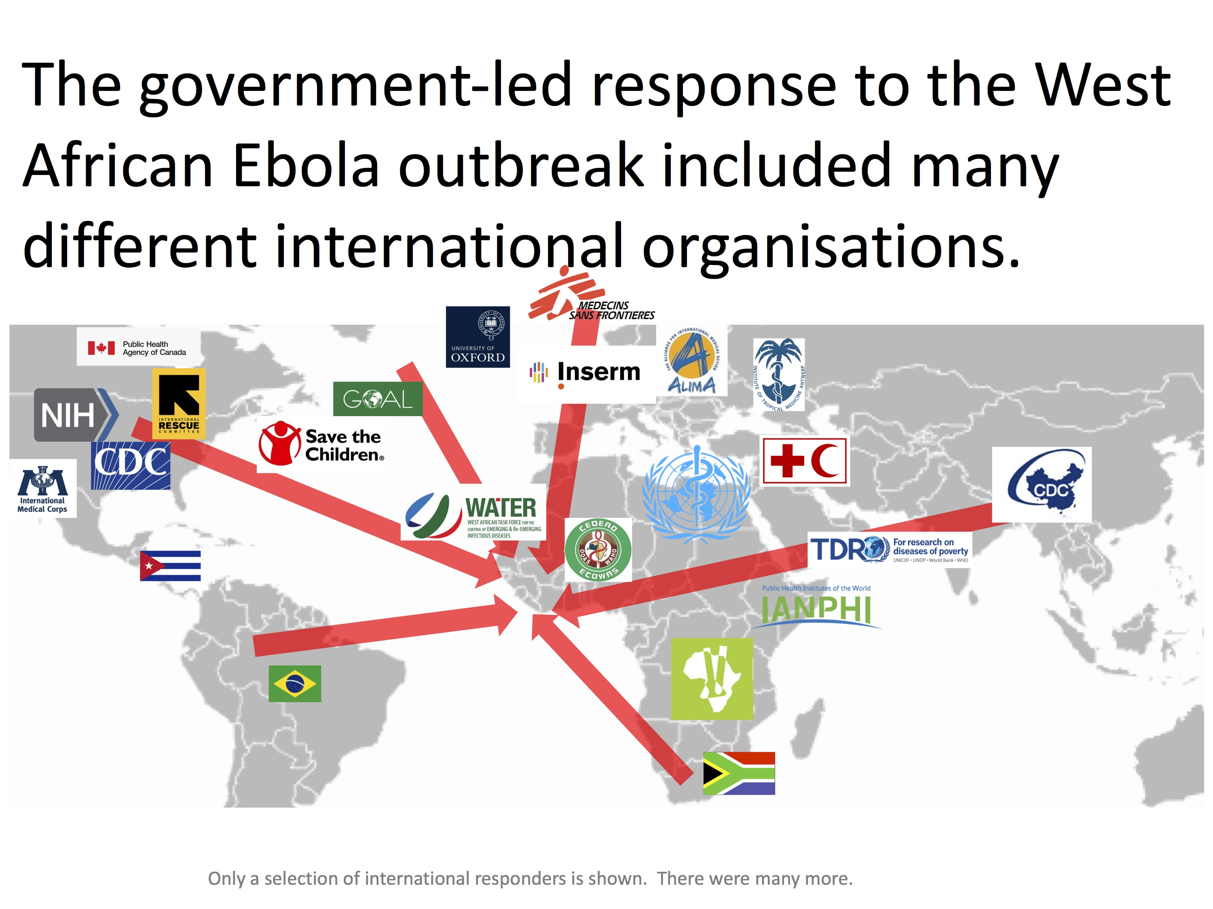
Slide Credit: Laura Merson, IDDO
West African Ebola Outbreak, 2014-2016.

Slide 15
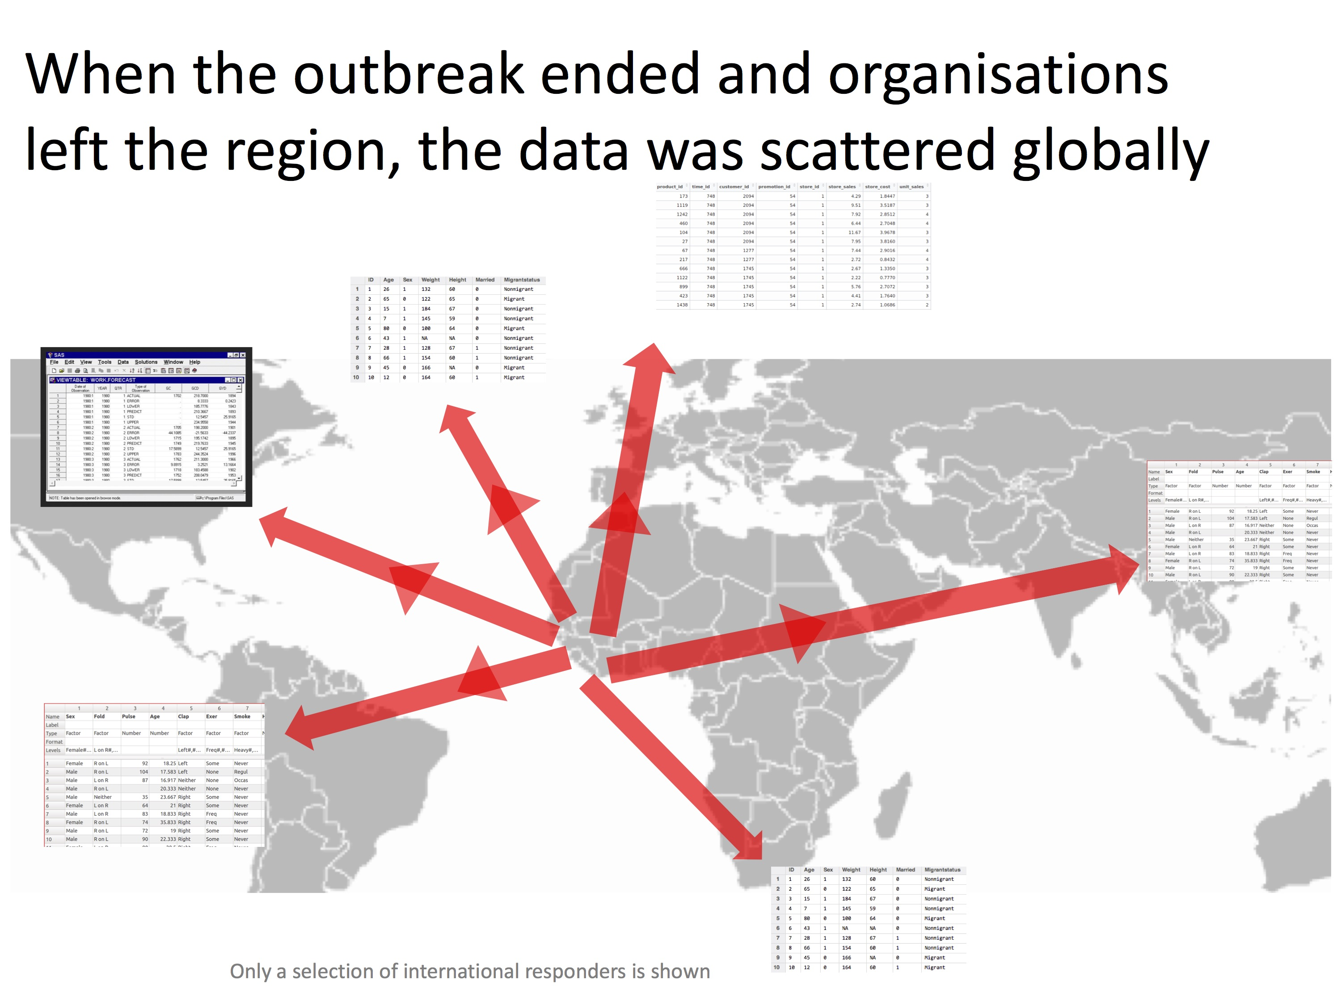
Slide Credit: Laura Merson, IDDO
West African Ebola Outbreak, 2014-2016.
Pisani et al. 2018 Estimate 65% of study data not available, not shared.

Slide 16
Data aggregation is essential for research and action.
Barriers to data aggregation impede research and action.
65% of data was not shared, made available (finding in E. Pisani et al. Data sharing in public health emergencies. Wellcome Trust, 2018.)
Most data cannot be accessed directly at the record level (e.g. summarised in studies and not shared).
Most clinical records from the outbreak are pdf scans.
Lack of metadata (data / information about the data which allows the data to be discovered, aggregated, integrated).
Lack of a data dictionary (a set of definitions that allows the variables in the data to be understood).
Technically challenging to integrate and analyse trials data and clinical data; and other relevant data (e.g. genomic data, vector data, transport and environmental data etc).
Slide Credit: Fernando Gouveia Reis and Laura Merson, IDDO

Slide 17
Data that characterise many of the factors influencing the progression of an outbreak are available, but remain isolated in siloes within the various domain- specific communities, often with their own domain-specific formats, vocabularies and ontologies.
Availability of datasets from industry, the research community, national public health surveillance, climate and environmental monitoring systems, health systems administration, social media feeds, and animal health services will then be sought in order to understand how their integration can fill critical knowledge gaps across disciplines. Reports and lessons learned from previous infectious disease outbreaks have identified clinical, genomic, demographic, pathogen and vector surveillance, communications, land-use, health administration, and environmental data as powerful inputs to support planning and operationalising outbreak response. We can anticipate data in numerous formats such as tabular data in spreadsheets, CSV, TSV, and/or plain text, geospatial point-wise data, geographic data, and a variety of XML and JSON dialects. For the domains of interest, available ontologies will be sourced and compared to determine methods for integration and interchange.
Slide Credit: Fernando Gouveia Reis and Laura Merson, IDDO

Slide 18
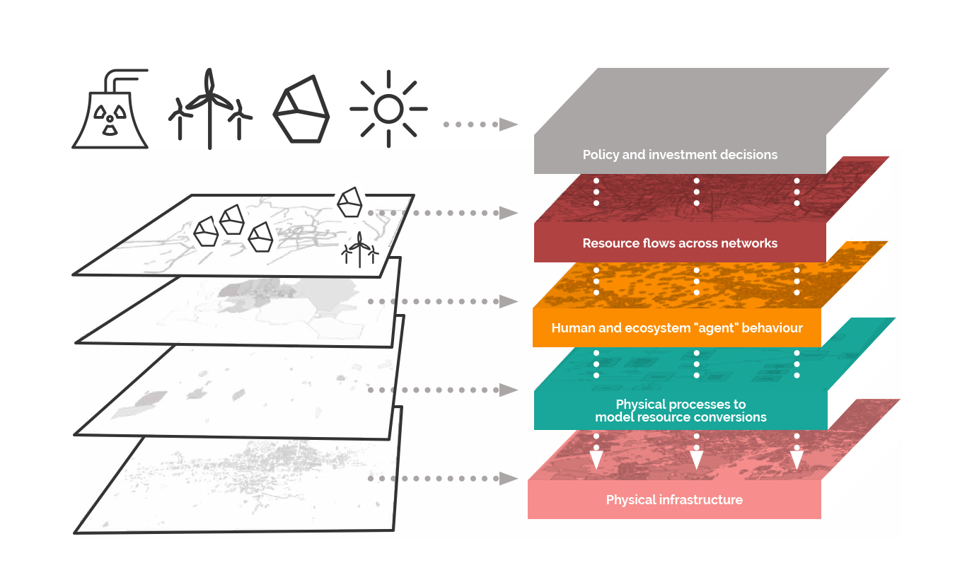

Resilience Brokers – resilience.io
New Science of Cities: test case par excellence of ability to integrate heterogeneous data and to model complex systems.
Resilience.io: An integrated-systems modelling platform that combines a suite of interlinking modules, including:
an agent-based model (ABM) simulates the population of the entire city-region, their choices, consumption patterns and behaviours.
a growing library of input-output process blocks (resource conversions) for process optimisation that describe all of the energy and materials flows of a city-region system. These processes are geo-located to build up an integrated systems network based on the actual functions of a city or other geography.
Case studies with Accra, Ghana (water resources); and, with Medellîn, Colombia (on pollution, health outcomes and economic impact).
Slide Credit: Stephen Passmore and Andrew Simmons, Resilience Brokers

Slide 19
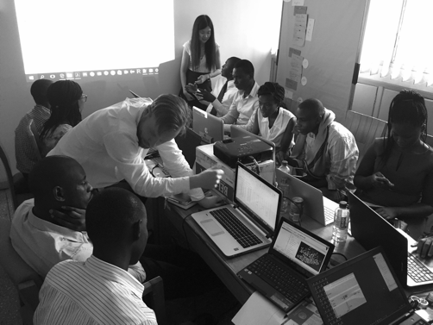




Resilient Cities Findings and Recommendations
Greater Accra Metropolitan Areas water modelling initiative, required major collaborative co-design effort to create the system and to prepare and integrate the datasets.
Allowed modelling of water needs, by district; costing of solutions (desalination plants etc); consideration of impacts and modelling of economic outcomes.
Effective approach and demonstrates the utility of the resilience.io platform.
Challenges of data quality and metadata quality.
Improved data stewardship; application of FAIR principles; improved semantics and metadata would greatly assist.
Demonstrates how data collection, processing and disseminating can be used for municipal decision-making lead to enhanced urban resilience.
Population socio-economics
Water access
Tariffs
Water and sanitation infrastructure in place
Infrastructure investment and operation cost
Water quality data
Water use per person
Water flow data and estimates,
Treatment capacity values
Rainfall data.
Datasets: https://africaopendata.org/dataset/greater-accra-population-socio-economics-and-water-access

Slide 20
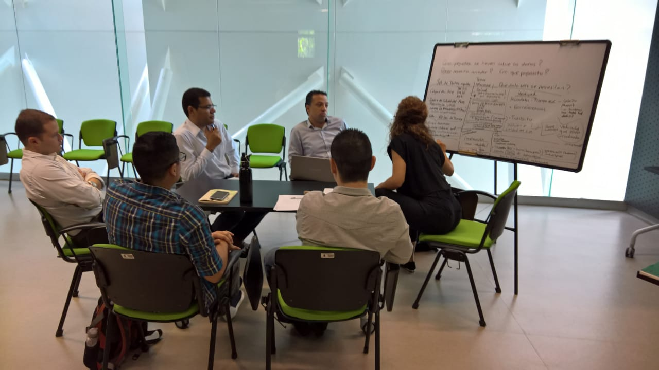

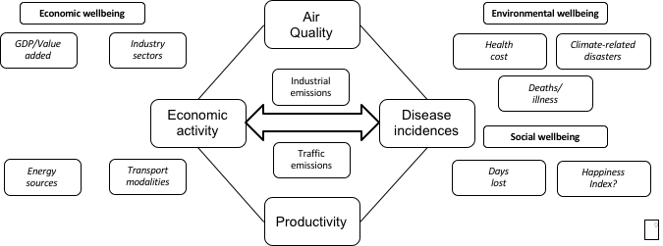
Resilient Cities Findings and Recommendations
Medellín has had a major push to enhance availability of open data: good quality in terms of coverage of sectors, detail and completeness.
Significant interoperability challenges in spatial and temporal parameters measured (e.g. air pollution recorded at daily or hourly intervals vs. hospital visit records that are aggregated annually).
Valuable to enhance standards and definitions for metadata, research approaches and methodologies for the measurement of city- and region-level indicators.
FAIR principles, discovery / collection level metadata and alignment of variable specifications can play a role.
Slide Credit: Stephen Passmore and Andrew Simmons, Resilience Brokers

Slide 21
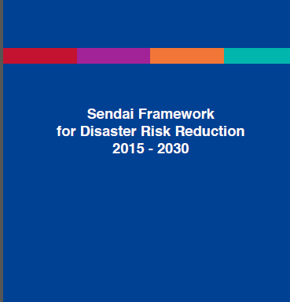
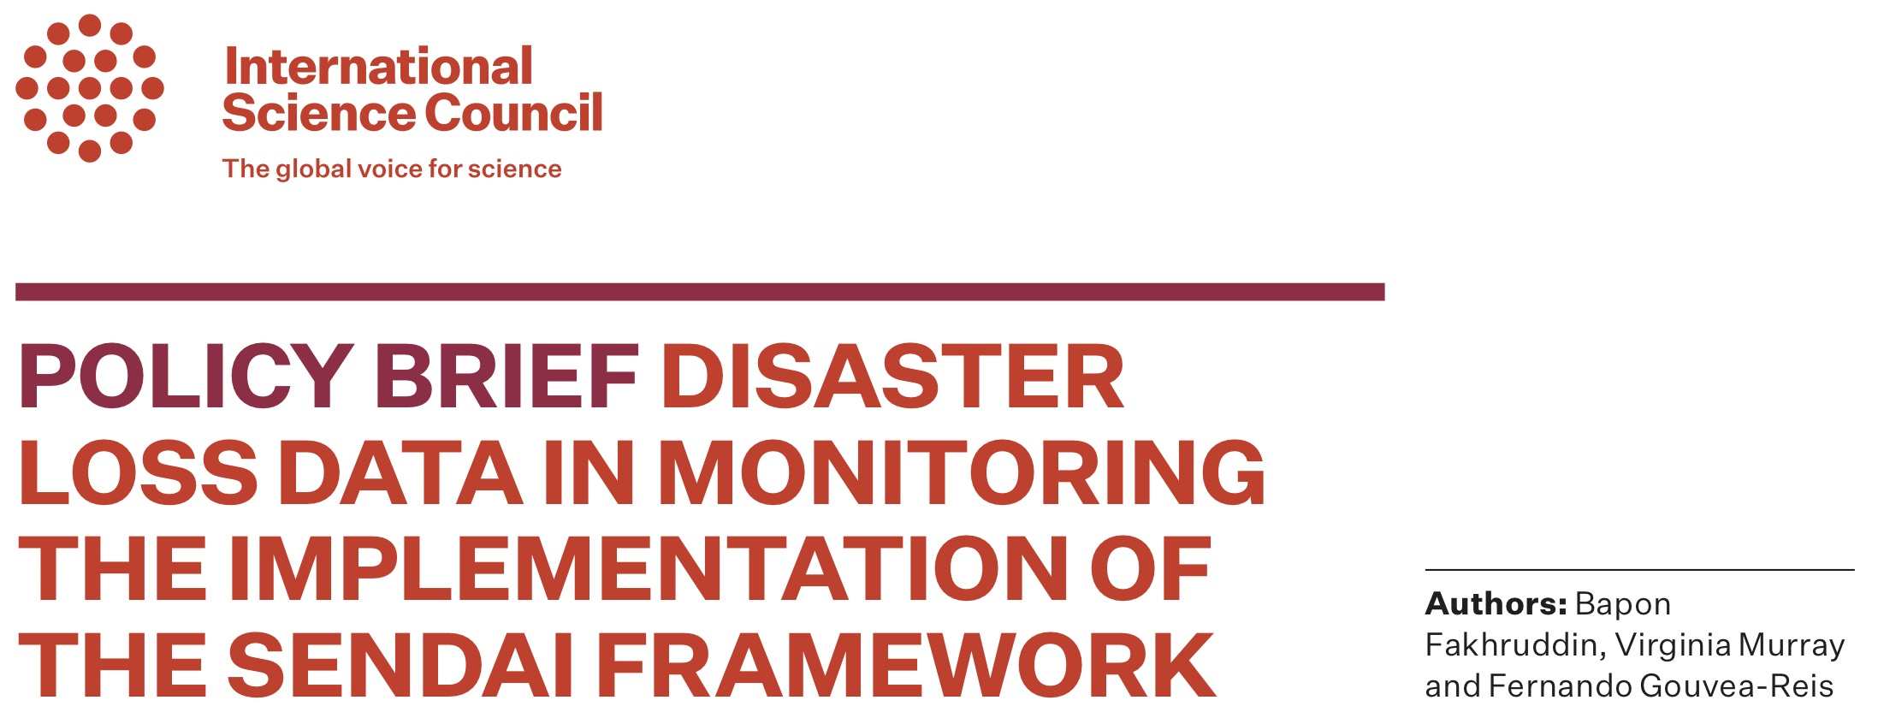
Disaster Risk Reduction
Pilot case study engaged with UNDRR, IRDR, ISC and others on challenges of Sendai reporting.
Focussed on specific challenges with mortality reporting: uncovered major challenges of data quality, inconsistent definitions, demonstrable under estimating of mortality.
Lack of data: not enough data are reported by those already reporting, and the need to support countries who have yet to start reporting;
Concerns on data quality: within individual country reports, there is a concern that the data reported appears to underestimate the impacts caused by different hazards.
Lack of agreement of hazards to be identified and their related definitions.
Recommendations
The absence of standardised hazards definitions is a critical issue that affects the identification, assessment, and analysis of hazards. A UNDRR-ISC technical working group on the review of Sendai Hazard Terminology and Classification has been established and will report in November 2019.
Recommendations on the contribution of data science to the Sendai process. Adoption of FAIR principles, in particular metadata for discovery and community specifications to ensure commensurability of data.
Develop standard protocols for exchanging data and metadata, and standard services for querying, retrieving, and performing other common functions.
Slide Credit: Virginia Murray, PHE and CODATA

Slide 22
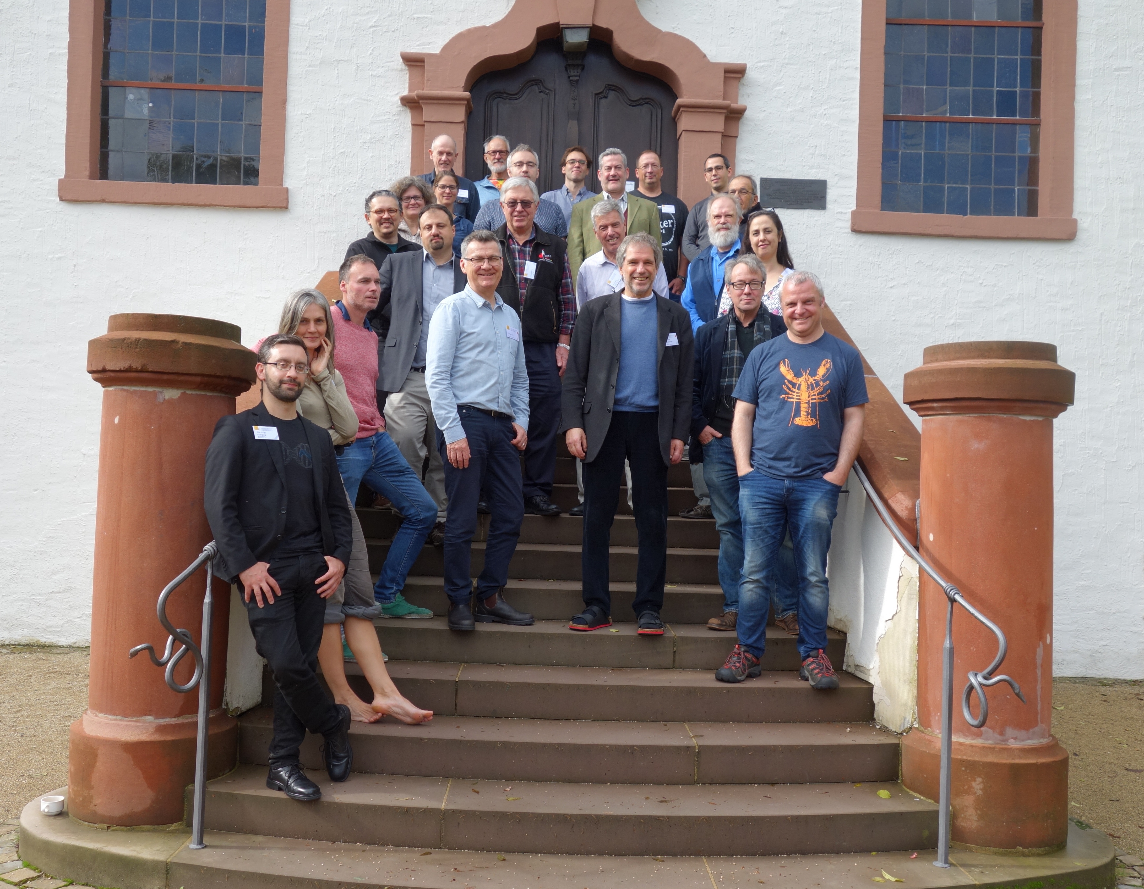

Interoperability of Metadata Standards in Cross-Domain Science
Dagstuhl Workshops in partnership with Data Documentation Initiative (DDI) in 2018 and 2019
Detailed examination of the requirements and the challenges of the pilot case studies.
2019: Sustainable Development Goals, Disaster Risk Reduction, Infectious Diseases, Resilient Cities.
Exploration of how DDI and other specifications can better align to facilitate interoperability and the linking and combination of data.
2019: Working Groups explored alignment of key ontologies, systematising necessary data transformations, interoperability issues for the case studies, particularly SDGs and HIV and health data.

Slide 23
ISC Science Action Plan: Project 2.1
A Decadal Programme: making data work for cross domain challenges
1: Making Data Work
Programme of technical and consensus building activities for interoperability
2: Advancing Interoperability through Cross Domain Case Studies
3: Mobilising Domains and Breaking Down Silos
3

Slide 24
Designing the Decadal Programme
Methodology
Designing the productive dynamic between the metadata experts and the case studies.
FAIR DO, alignment of metadata specifications and ontologies.
Engagement with concrete applications.
Partnerships:
Building partnerships with: international data and science organisations (RDA, GO FAIR); cross-domain initiatives; research groups and centres; domain organisations etc.
Delivery Mechanisms
Fund raising;
Distributed programme offices;
CODATA (and other partners) Centres of Excellence;
Joint projects with partners;
Contribution of effort (in kind) from partners.

Slide 25

A Decadal Programme: making data work for cross domain challenges
Aim is to launch the programme at the ISC GA and associated events ‘Global Knowledge Forum’ in Oman, 10-14 October 2021: https://council.science/about-us/governance/general-assembly/muscatassembly

Slide 26
Data Policies
Data Science
Data Skills
Data Good Practices
CODATA Data Policy Committee http://bit.ly/data-policy-committee;
One major policy report per year.
20-Year Review of GBIF currently underway.
New Centre of Excellence in Data for Society being set up at University of Arizona.
CODATA-RDA School of Research Data Science.
CODATA China, PASTD and other training activities.
#terms4FAIRskills and FAIRsFAIR Competence Centres.
Data Science Journal: https://datascience.codata.org/
International Data Week and CODATA Conference series.
Task Groups and Working Groups.
Regional Open Science Platforms
Data Interoperability for Multi-Disciplinary Research.
Survey and recommendation of good practices.

Slide 27
Data Policy Committee
Major Reports Since 2015
20-Year Review of GBIF, to be published late 2019.
European Commission Expert Group, Chaired by Simon Hodson, Turning FAIR into Reality (2018) https://doi.org/10.2777/1524
Business models for sustainable research data repositories (with OECD, 2017) https://doi.org/10.1787/302b12bb-en
Guidelines for the Legal Interoperability of Research Data (with RDA, 2016) https://doi.org/10.5281/zenodo.162241
The Value of Open Data Sharing (for GEO, 2015) http://dx.doi.org/10.5281/zenodo.33830
The Science International Accord on Open Data in a Big Data World (for ICSU, 2015) http://www.science-international.org/#accord
Current Best Practice for Research Data Management Policies (for Danish e-Infrastructure Cooperation, 2015) http://dx.doi.org/10.5281/zenodo.27872
Data Policy Committee Subgroups
Upstream-Downstream Subgroup: investigating the underlying issues in the relationships of not-for-profit research data and commercial innovation.
Data Diplomacy Subgroup: examining topics around the use of data in the diplomatic process. Building a collaboration with INGSA (International Network of Government Science Advisors) https://www.ingsa.org/ and SPIDER (Science Diplomacy Division of INGSA).
Exploring issues of data policy education and an update of the 2015 survey of good practice in data policies.
Chair of Data Policy Committee until 2021 is Paul Uhlir, a world renowned expert in data policy issues.

Slide 28

Centre of Excellence in Data for Society
Partnership with University of Arizona
The Committee on Data of the International Council for Science (CODATA) and the University of Arizona (UA) are pleased to announce their new partnership in the CODATA – UA Center of Excellence in Data for Society (CEDS).
CEDS studies the use, practice, governance, and impact of data on societies across the globe
First step in a strategy to establish or partner on regional, thematic centres or programme offices for parts of the CODATA strategy.
A Centre of Excellence on technical issues will be established in Beijing this year. Discussions with the Kenyan Government for a Centre of Excellence in FAIR Data.
CEDS Global Data Forum
CEDS first initiative will be an an innovative series of information gathering events that will be held at host institutions in China, Brazil, Canada, South Korea, the US, the Middle East, Africa, and Europe.
The Forum is designed to achieve several goals:
To meet with an inclusive community of data stakeholders
To discuss emerging trends in data production, use, and management
To reveal new opportunities for collaboration
To identify persistent challenges
To organize novel networks of stakeholders across sectors
To create policy and diplomacy options for sustainable solutions

Slide 29
African Open Science Platform
See http://www.codata.org/strategic-initiatives/african-open-science and http://africanopenscience.org.za/
Three year pilot project funded by DST and NRF in South Africa, delivered by ASSAf, directed by CODATA.
Advocacy and community building.
Landscape survey of Open Science and data initiatives in Africa.
Framework documents on: data policies, incentives, training, RDM in institutions and data infrastructure.
Vision and Strategy Document: https://doi.org/10.5281/zenodo.2222418
Federated network and cloud facilities.
Open science, FAIR and RDM tools.
Data Science and AI Institute.
Inter-disciplinary global challenge projects
Community network for education and skills in FAIR data and Open Science.
Network for societal engagement and participation.
Delivery Phase Planning Workshop – First Members’ Meeting, Alexandria, Egypt, 2-3 September
Stakeholders: international donors, grant funding councils, academies, NRENs, pan-African research projects, data initiatives, university consortia…
Moving to phase two…

Slide 30
Regional Open Science Platforms…
Another strand of the draft ISC Science Action Plan.
Exploring similar initiatives in Asia Pacific Region and in Latin America.
Mission for the ISC Regional Offices.
Malaysian Open Science Platform: Malaysian Academy working with the five research
ISC ROAP will lead a APEC (Asia Pacific Economic Cooperation) project to survey and scope the Open Science landscape.
Exploring options for ASEAN or wider regional cooperation around Open Science.

Slide 31
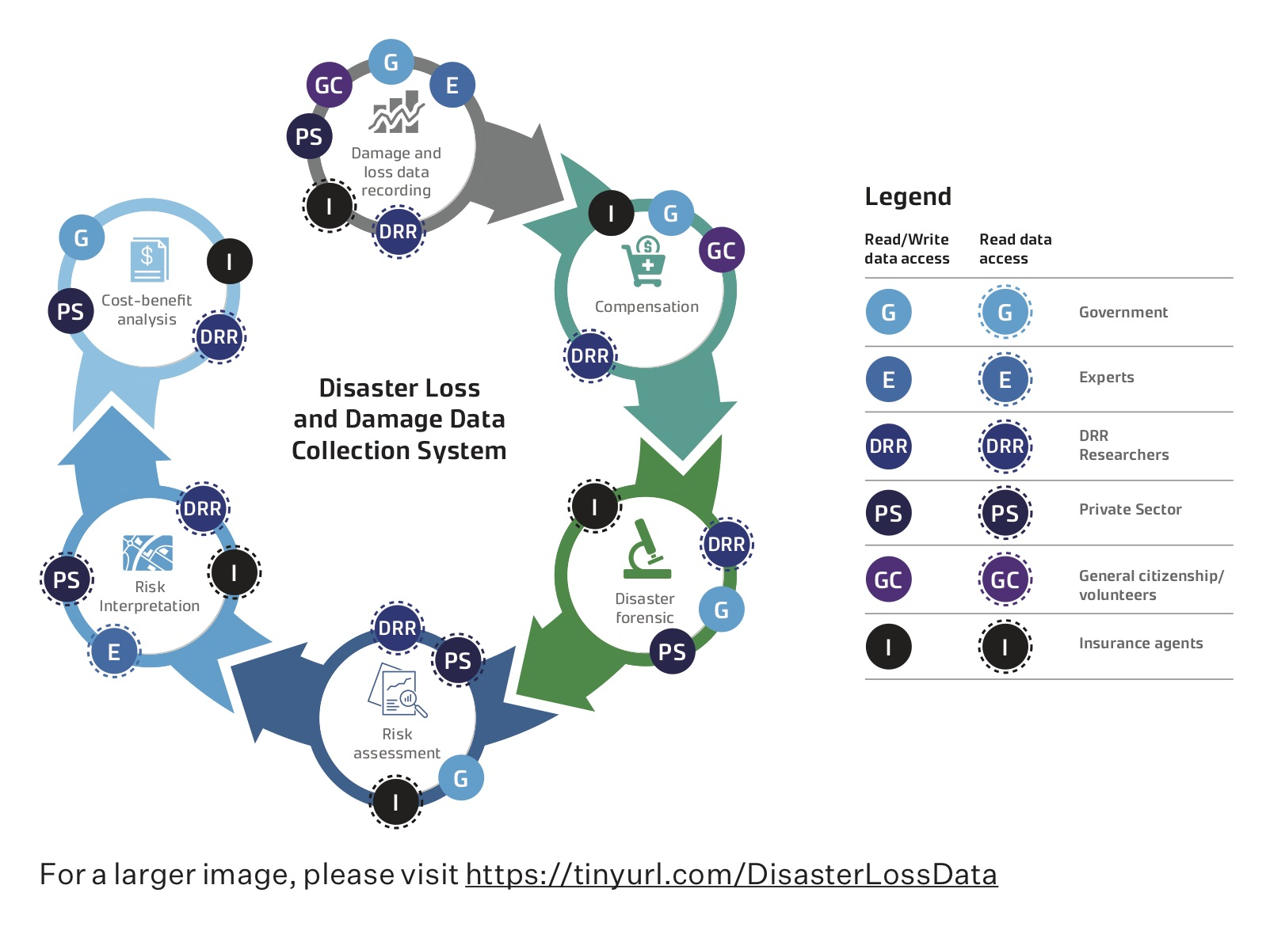
CODATA Task Groups
Advanced mathematical tools for data-driven applied systems analysis
Applying Data Integration and Data Science Tools toward Research of Urban Life and Smart Cities
Digital Representation of Units of Measure (DRUM)
Improving Data Access and Reusability (IDAR-TG) - particularly for data at risk…
Agriculture Data, Knowledge for Learning and Innovation – Kenyan led.
Citizen Science for the SDGs – Aligning Citizen Science outcomes to the UN Sustainable Development Goals
Linked Open Data for Global Disaster Risk Research – very active in DRR, white paper currently out for review.
Preservation of and Access to Scientific and Technical Data in/for/with Developing Countries (PASTD) – focusing on LMICs
http://bit.ly/TGGDRR-White_Paper_2

Slide 32
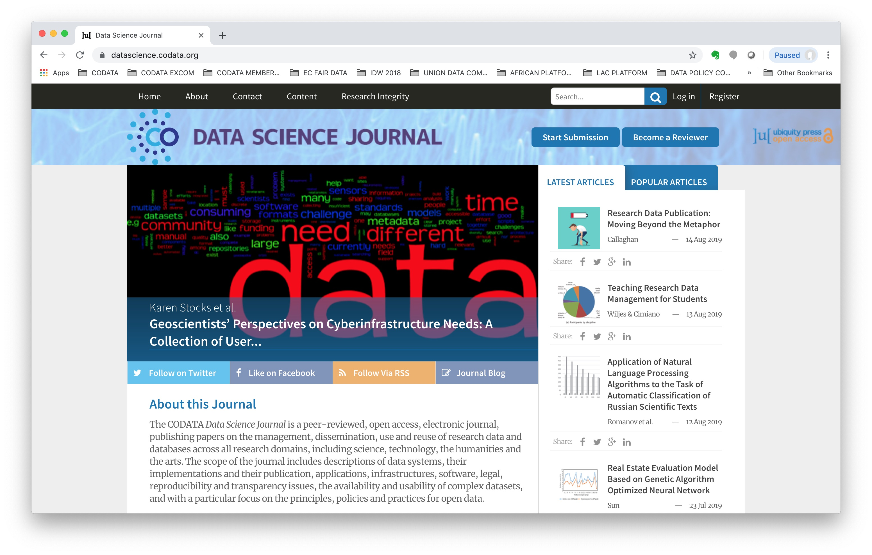

Slide 33
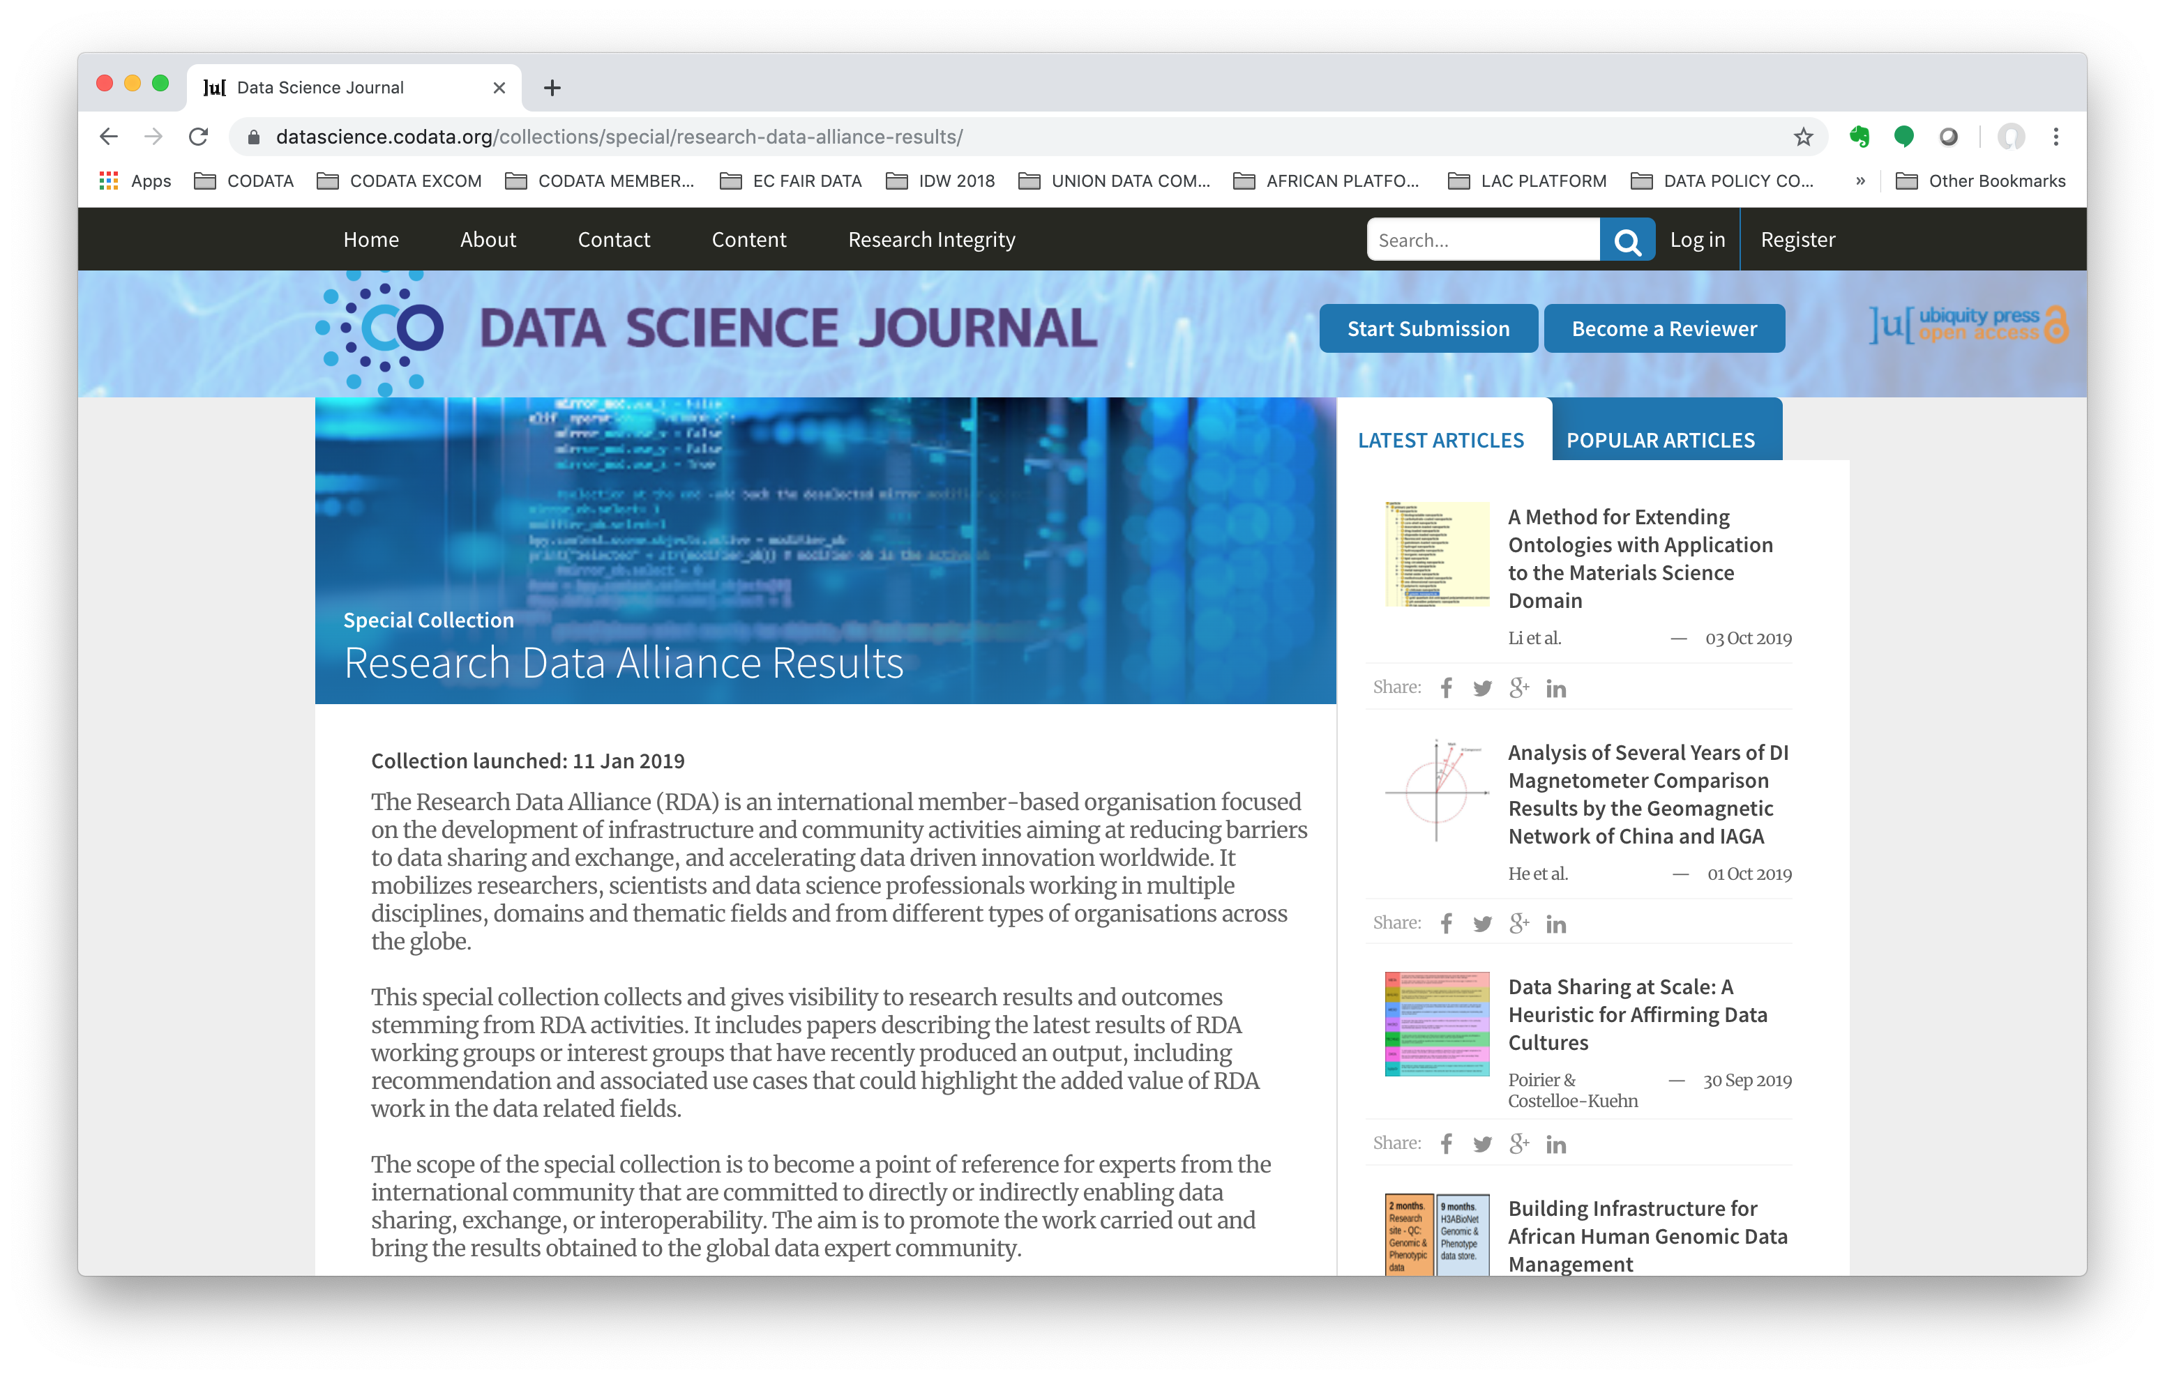

Slide 34
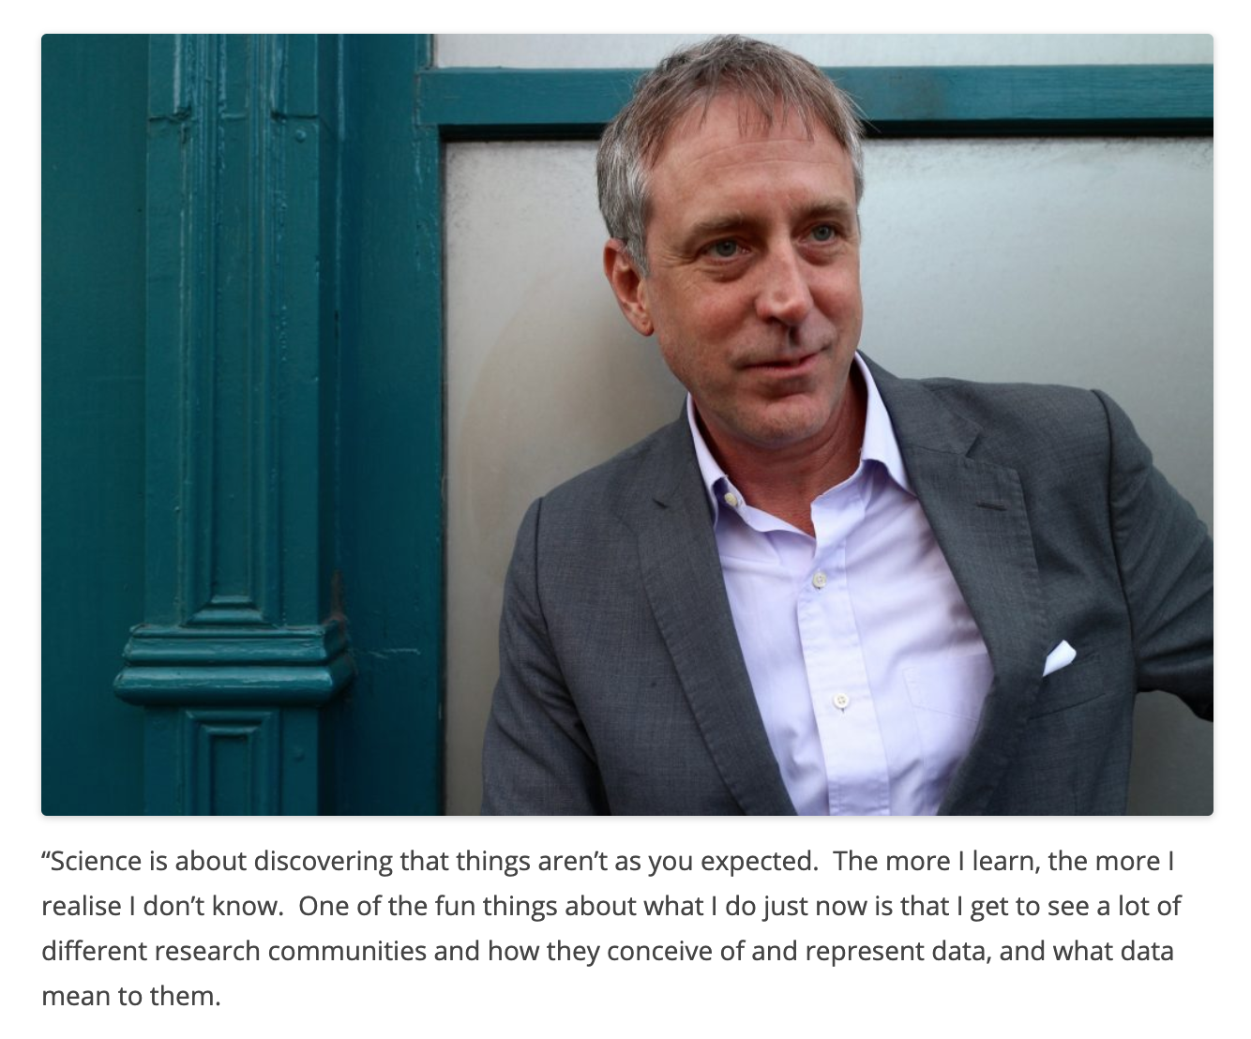
Humans of Data
The Editor-in-Chief of the Data Science Journal is Human of Data 13
http://codata.org/blog/category/humans-of-data/
Humans of Data is an art intervention into the international research data community by Laura Molloy laura@codata.org / @LM_HATII
Images CC-BY-NC Laura Molloy

Slide 35
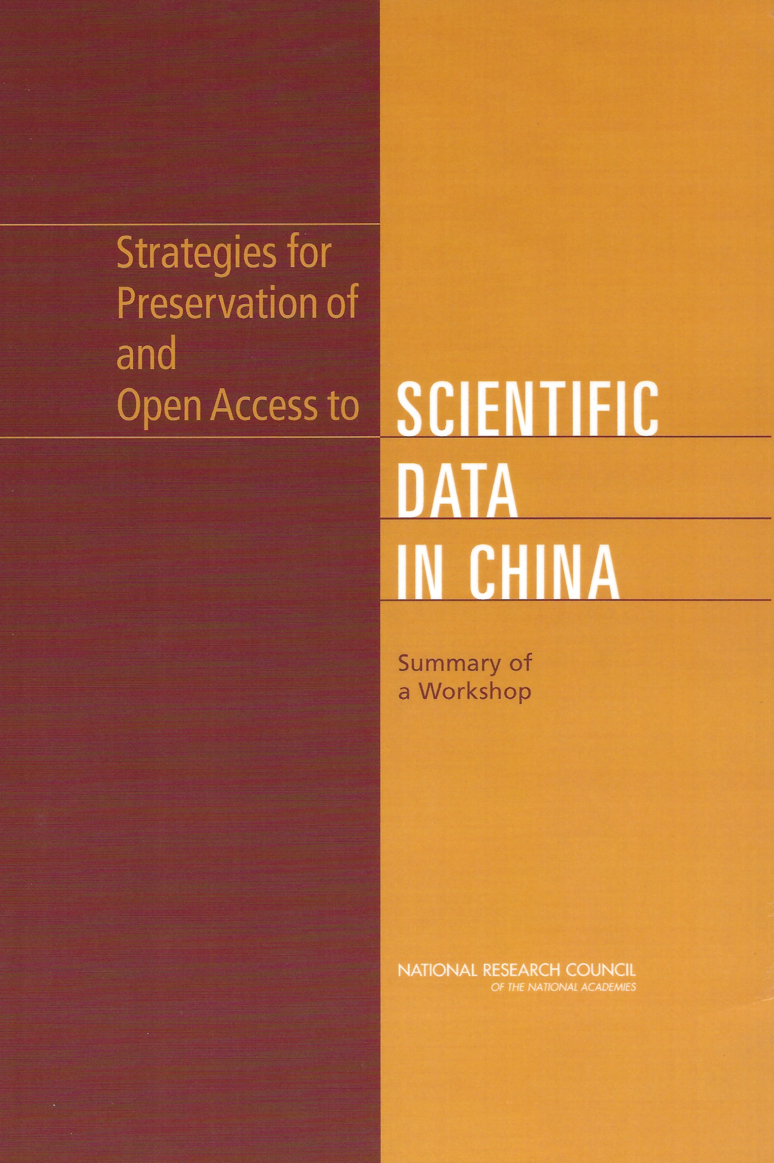
High Level Policy and Strategy Workshop: Implementing Open Research Data Policy and Practice, Beijing, 17-18 September.
Examines the theme in China and elsewhere, in the light of the emergence of data policies and in particular the China State Council’s Notice on ‘Measures for Managing Scientific Data’.
Strong tradition of influential events in China. 2004 and 2008 workshops credited with leading to considerable CAS investment in data platforms.
Important opportunity for comparative discussions.
CODATA 2019 Beijing Conference, 19-20 September
Information: http://codata2019.csp.escience.cn/dct/page/1
Programme: https://conference.codata.org/CODATA_2019/programme/
Timely to examine changes in data policy, emergence of FAIR, major initiatives such as EOSC, ARDC, and CAS activities including the Digital Belt and Road.
Ongoing series of CODATA Conferences.

Slide 36
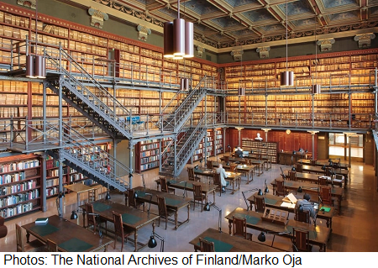
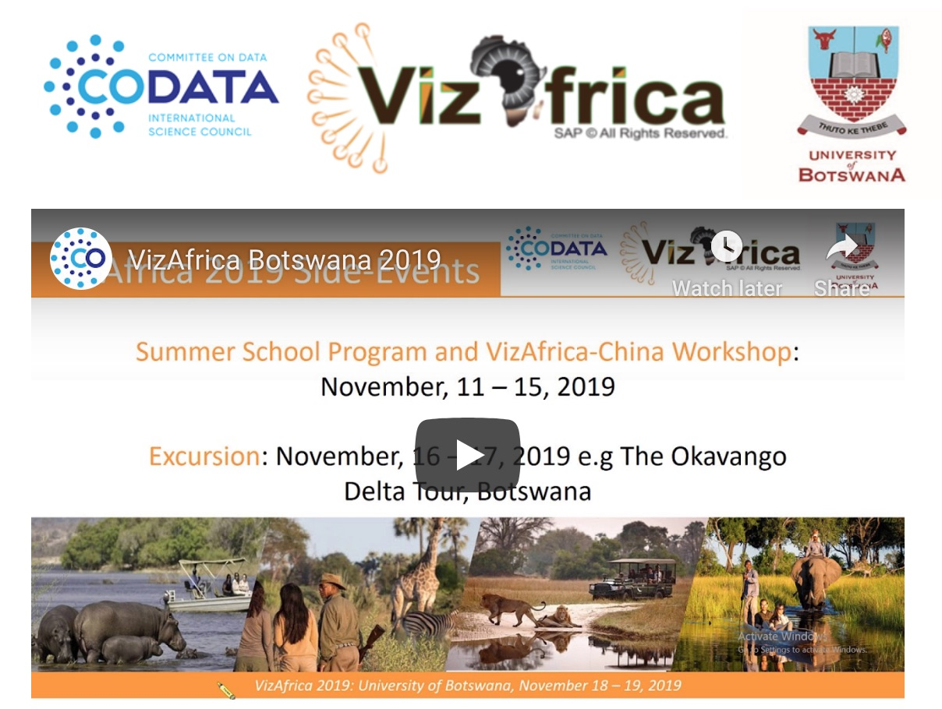
CODATA Conferences
CODATA-Helsinki Workshop on FAIR RDM in Institutions 2019: https://conference.codata.org/Helsinki-CODATA-2019/
National Archives of Finland, Helsinki, 20-21 October
VizAfrica 2019 Botswana: https://vizafrica.codata.org/2019-Botswana/ and http://bit.ly/VizAfrica-Botswana
University of Botswana, Gaborone, 18-19 November
Registration still open: https://vizafrica.codata.org/conference/2019-Botswana/register/
Call for Applications to Host International Data Week 2021 or 2023, deadline: http://www.codata.org/news/338/62/Call-for-Applications-to-Host-International-Data-Week-2021-or-2023
Next CODATA Conference, Oct-Dec 2020: TBA

Slide 37
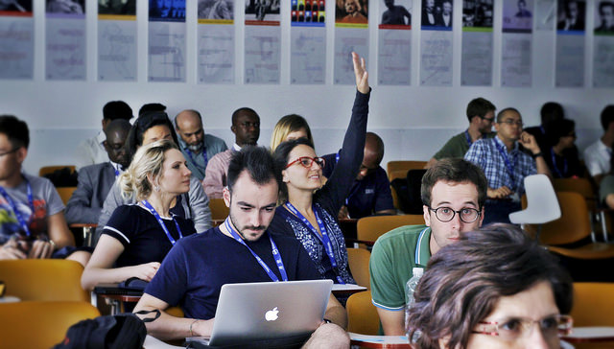
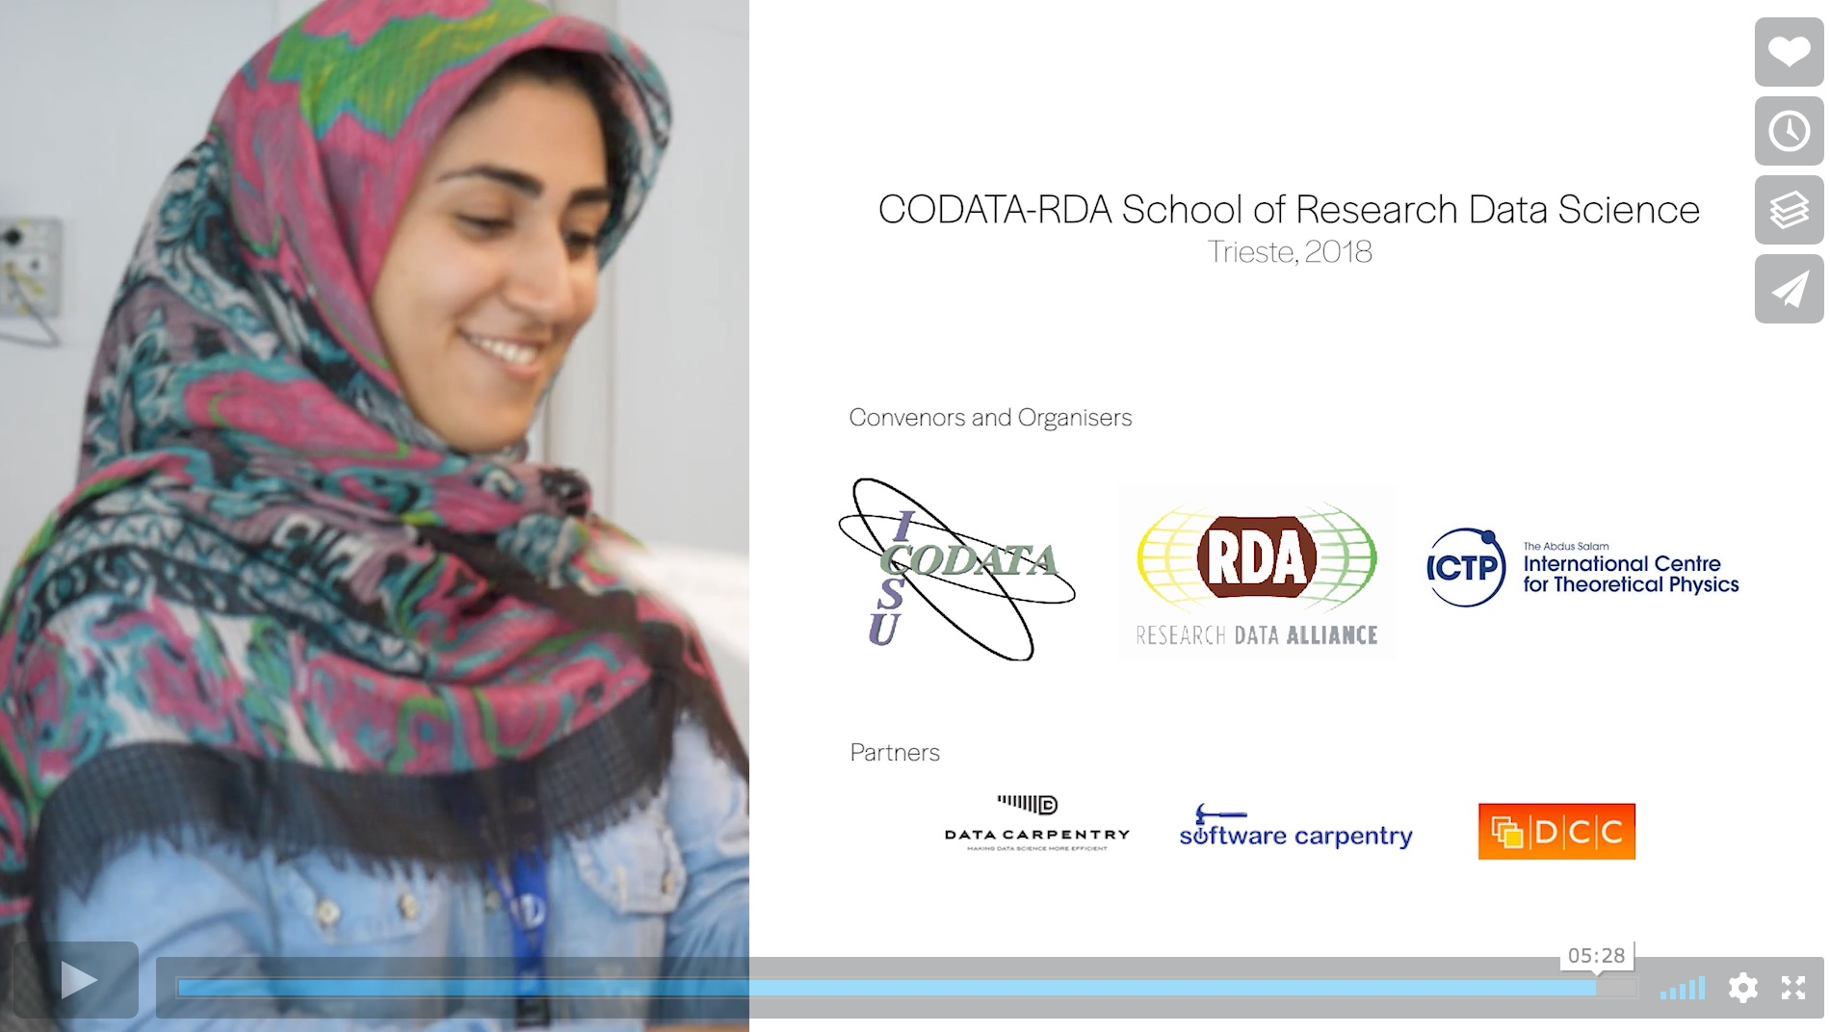
Data Skills and Training
Regular Beijing Data Science Training Workshops (last one Sept 2019)
FAIRsFAIR and GO Train activities: adding data stewardship and train-the-trainer components.
Initiative to develop a community recognised terminology for FAIR data competencies: #terms4FAIRskills
See: http://www.codata.org/fair-data-training and https://terms4fairskills.github.io/Announcement.html
CODATA-RDA Schools of Research Data Science: http://bit.ly/CODATA-RDA-data_schools
Film: https://vimeo.com/299263596
Deadline for Pretoria, 31 October: http://bit.ly/data-school-pretoria
2020: Pretoria, Abuja, Trieste…
2019: Addis, Trieste, Trieste Advanced Workshops, Costa Rica.
2018: Brisbane, Trieste, Trieste Advanced Workshops, Kigali, São Paulo
2017: Trieste, Trieste Advanced Workshops, São Paulo
2016: Trieste

Slide 38
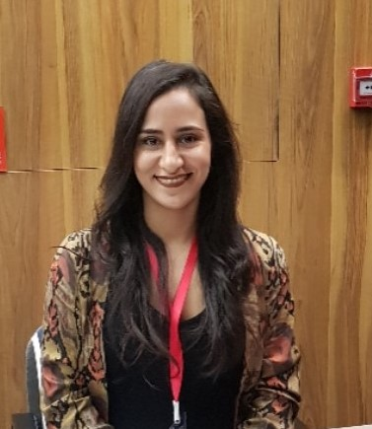
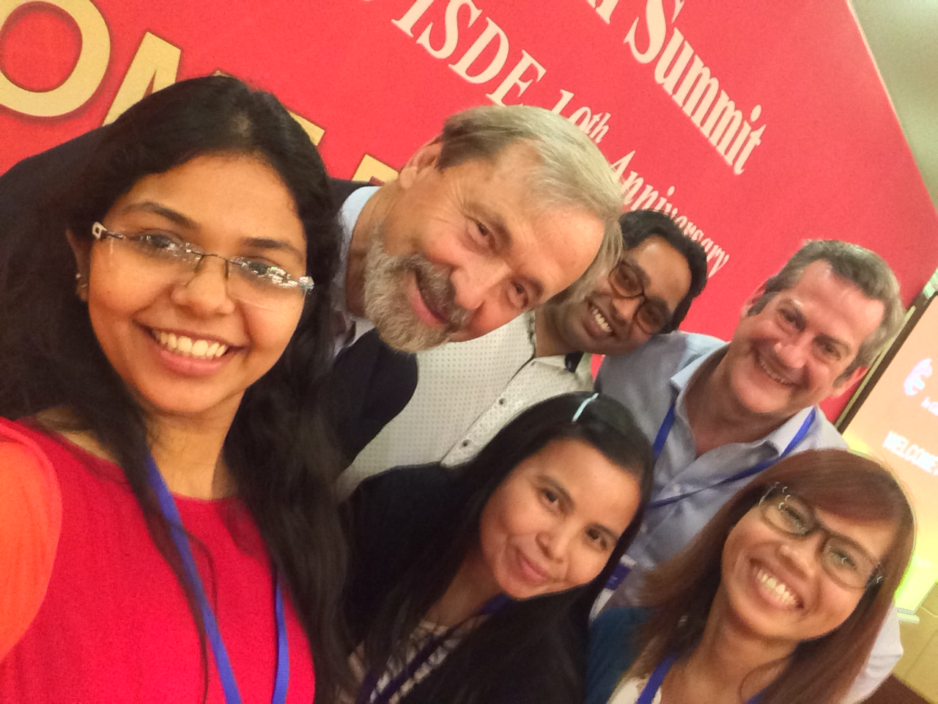
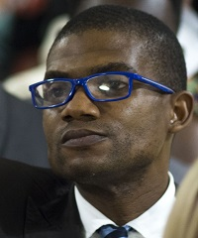
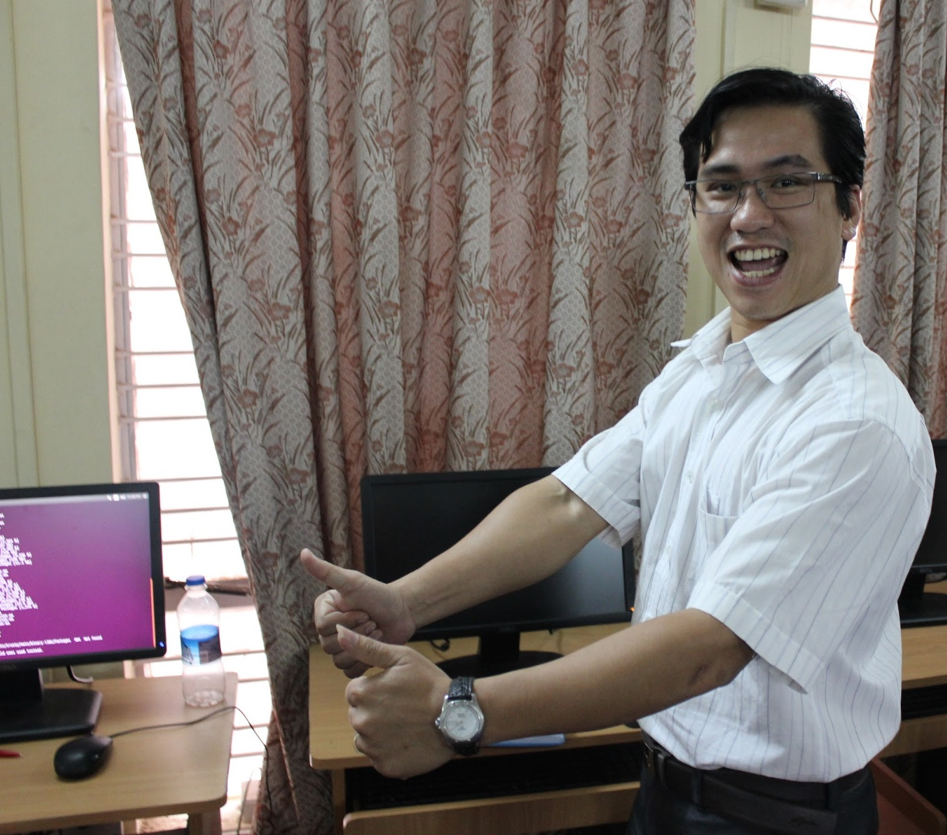
CODATA Early Career Data Scientists and Stewards
Aim to re-create an active group of Early Career Data Scientists and Stewards.
Alumni of Data Schools and Training Workshops.
Students > Helpers > Instructors > Directors…
Alumni Sara El Jadid and Marcela Alfaro now co-chairs of the Data Schools.
Felix Emeka Anyiam and others run the careers list.
Shaily Ghandi has been a helper at Trieste
Shaily and Felix organised a school on urban data science https://sws.cept.ac.in/course-detail/urban-data-science-S19FT001
Small grants to assist participation, running events, managing the careers list etc.
Sign up to CODATA lists for more information.

Slide 39
How to engage with CODATA?
Tell us what is most important to you! Engage with us on what we should be doing!
Active engagement with ISUs and in particular with their data and information committees / commissions, projects and initiatives.
Active National Committee: should be a bi-directional point of contact.
Institutional Membership now available with role in governance.
Decadal Programme: Making Data Work for Cross-Domain Challenges
Engage through this with data specifications experts, domain experts, unions.
African Open Science Platform, Task Groups, Data Policy Committee, Data Schools, Global Data Forum…
CODATA Conferences (e.g. Beijing 2019), RDM Conferences (next one is Helsinki with RDA in Oct 2019), VizAfrica in Nov 2019.
Call for EoIs to host International Data Week in 2021 or 2023.

Slide 40
Follow CODATA!
CODATA Website: http://www.codata.org/
CODATA Blog: http://codata.org/blog/
CODATA International News and Discussion List: http://bit.ly/CODATA-International-List
CODATA Data Science and Data Stewardship Careers List: http://bit.ly/CODATA_Careers_List
CODATA on Twitter: @CODATANews and @simonhodson99

Slide 41
Thank you for your attention Simon Hodson, CODATA www.codata.org simon@codata.org @simonhodson99 ; @CODATAnews

